Slide 1
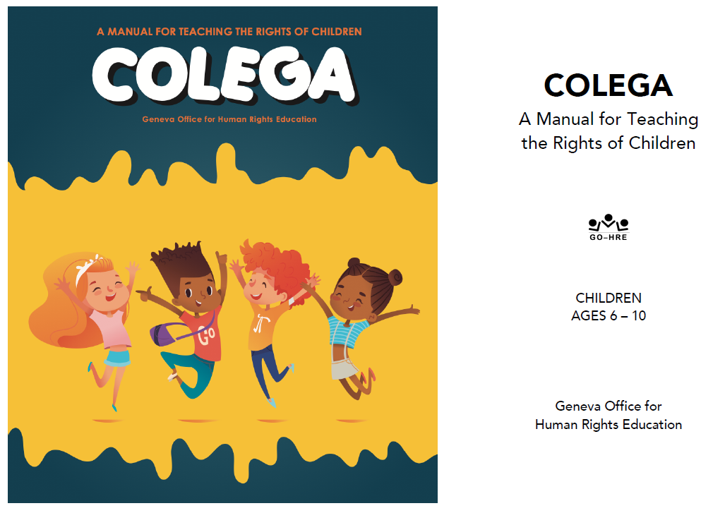

Slide 2
Facilitator Tips
1 | Sing the Song | Keep track of whose names have been used and make sure all children are included eventually in the song.
2 | Read Mini-Poster | When you read the mini-poster, take all responses on what is rights in a positive manner
3 | Talking Stick | Use talking stick when students want to say something in a group, or, if the group is large, hold it up as a symbol to remind the children to take turns and listen respectfully when someone speaks.
4 | Write Down Notes and Reflections | Don't forget to fill out the notes and reflections section

Slide 3
Materials Needed
1 | Markers, Chalk, Flip chart, Chalkboard, Large piece of paper
2 | Pictures from the story of JoZy, the kangaraoo
3 | Picture: JoZy’s Bunny
4 | Mini Poster: The Right to be Free and Safe
5 | Illustrations for articles from the Universal Declaration from Lesson 1B
6 | Talking Stick
7 | Class Roll
8 | Class Rules

Slide 4
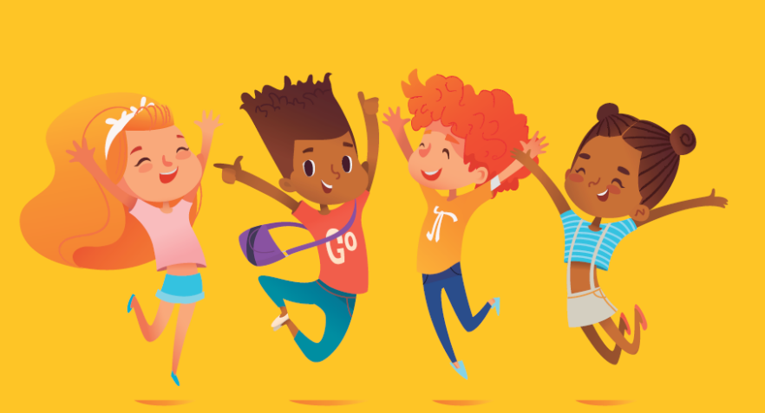
I Have Rights Lesson 2B
Free and Equal
We All Have the Right to Life, Freedom and Safety

Slide 5
Welcome and Warm Up
Notes:
WELCOME and WARMUP(5 minutes)
Greet each child enthusiastically upon arrival, and show her or him where to sit. Briefly introduce yourself and tell the children how happy and excited you are to be starting this course about human rights. Explain that you love human rights and that they will, too.

Slide 6
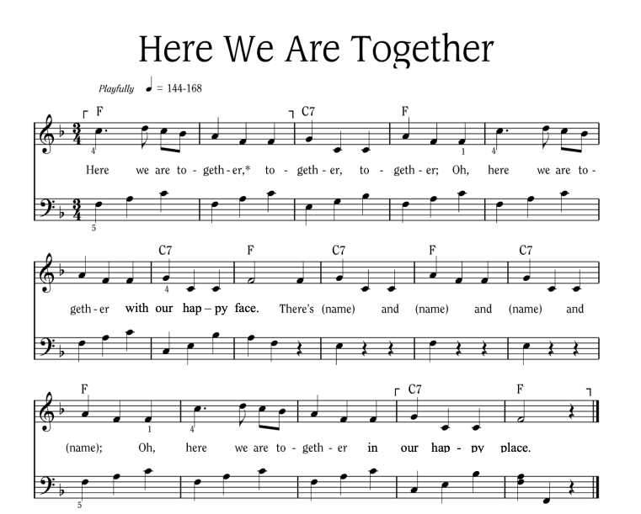
Notes:
Sing “Here We Are Together”
Sing the verse on your own, naming four different students. Point to the students and smile as you name them.
Repeat the song several times so that you can name many students.
To hear the melody:
To hear the melody: https://www.youtube.com/watch?v=XR9d7TsgQN8&list=PL1p11lCKMm7vUpyDMd39yUSVUUwUJ-Wa5&index=1
Sing with enthusiasm and delight.
Everyone: Here we are together, together, together. Here we are together with our happy face.
Facilitator: There’s Martha and Peter and Suzie and Henry (pointing to each of these children, one by one)
Everyone: Oh, here we are together in our happy place.
Sing the verse at least two or three times in a row so that you can name a few different children during each class.
Alternate Words:
Here we go a-walking
Here we are a-singing
Here we go a-marching
Here we are a-clapping
Make up actions based on the words! And you can make up your own words. Think of other phrases that might fit the music.

Slide 7
Here We Are Together
All
Here we are together, together, together,
Here we are together, with our happy face.
Teacher
There’s _________ and _________ and _________ and _________!
All
Oh, here we are together in our happy place!
Notes:
Sing “Here We Are Together”
Sing the verse on your own, naming four different students. Point to the students and smile as you name them.
Repeat the song several times so that you can name many students.
Everyone: Here we are together, together, together. Here we are together with our happy face.
Facilitator: There’s Martha and Peter and Suzie and Henry (pointing to each of these children, one by one)
Everyone: Oh, here we are together in our happy place.
Alternate Words:
Here we go a-walking
Here we are a-singing
Here we go a-marching
Here we are a-clapping
Make up actions based on the words! And you can make up your own words. Think of other phrases that might fit the music.

Slide 8
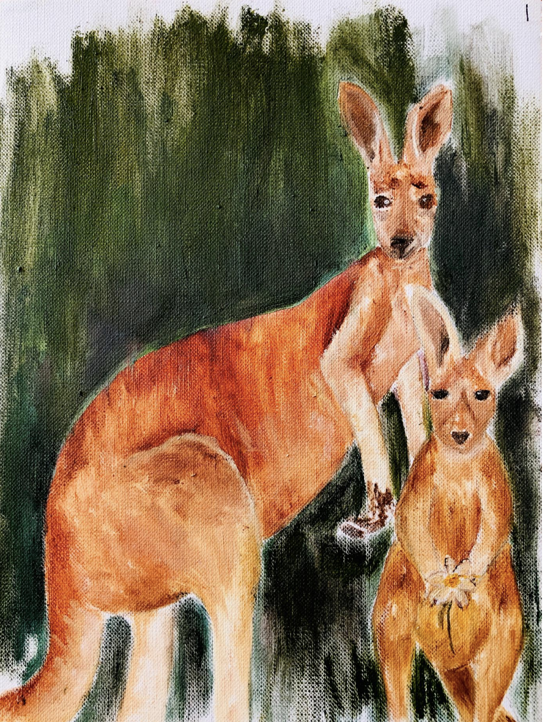
Review
Who can remember our story “A Pet for JoZy, the Red-Haired Joey”
What did JoZy want for a pet?
Notes:
(5 minutes)
Say: I’m so happy that we’re all here together today to talk about human rights.
Show the pictures from the story of JoZy, the kangaroo.
Ask: Who remembers our little kangaroo, and what her name was?
JoZy is a kangaroo who wants a red-haired, blue-eyed, freckled faced, little girl for a pet. She ends up being happy with a blue-tongued lizard called a “skink”.
Thank you for using the Talking Stick.

Slide 9
Learning Points
We need human rights for children to live in freedom and safety.
Human needs and human rights are connected.
Notes:
Human rights are necessary in order for all children to live in freedom and safety.
There is a strong connection between human need and human rights.

Slide 10
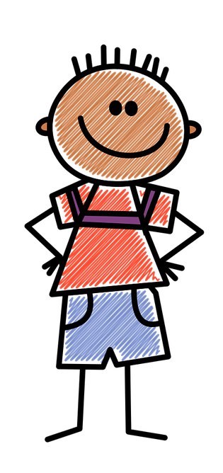
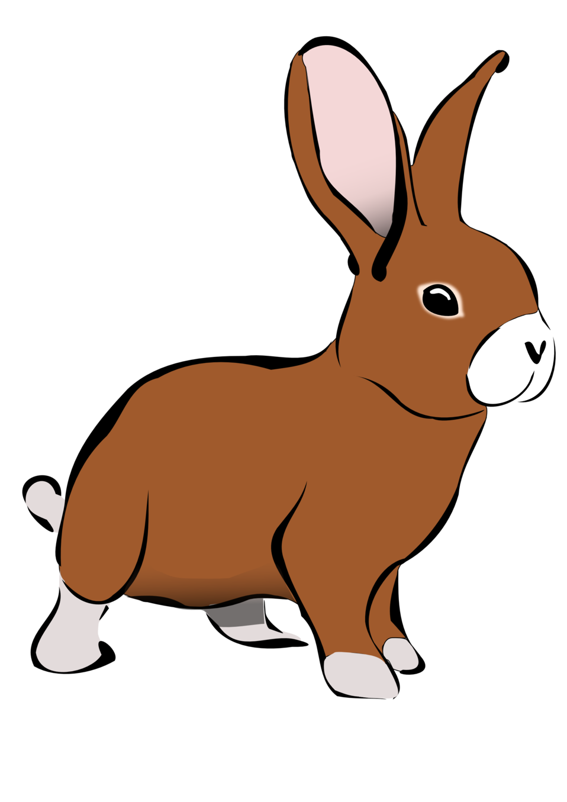
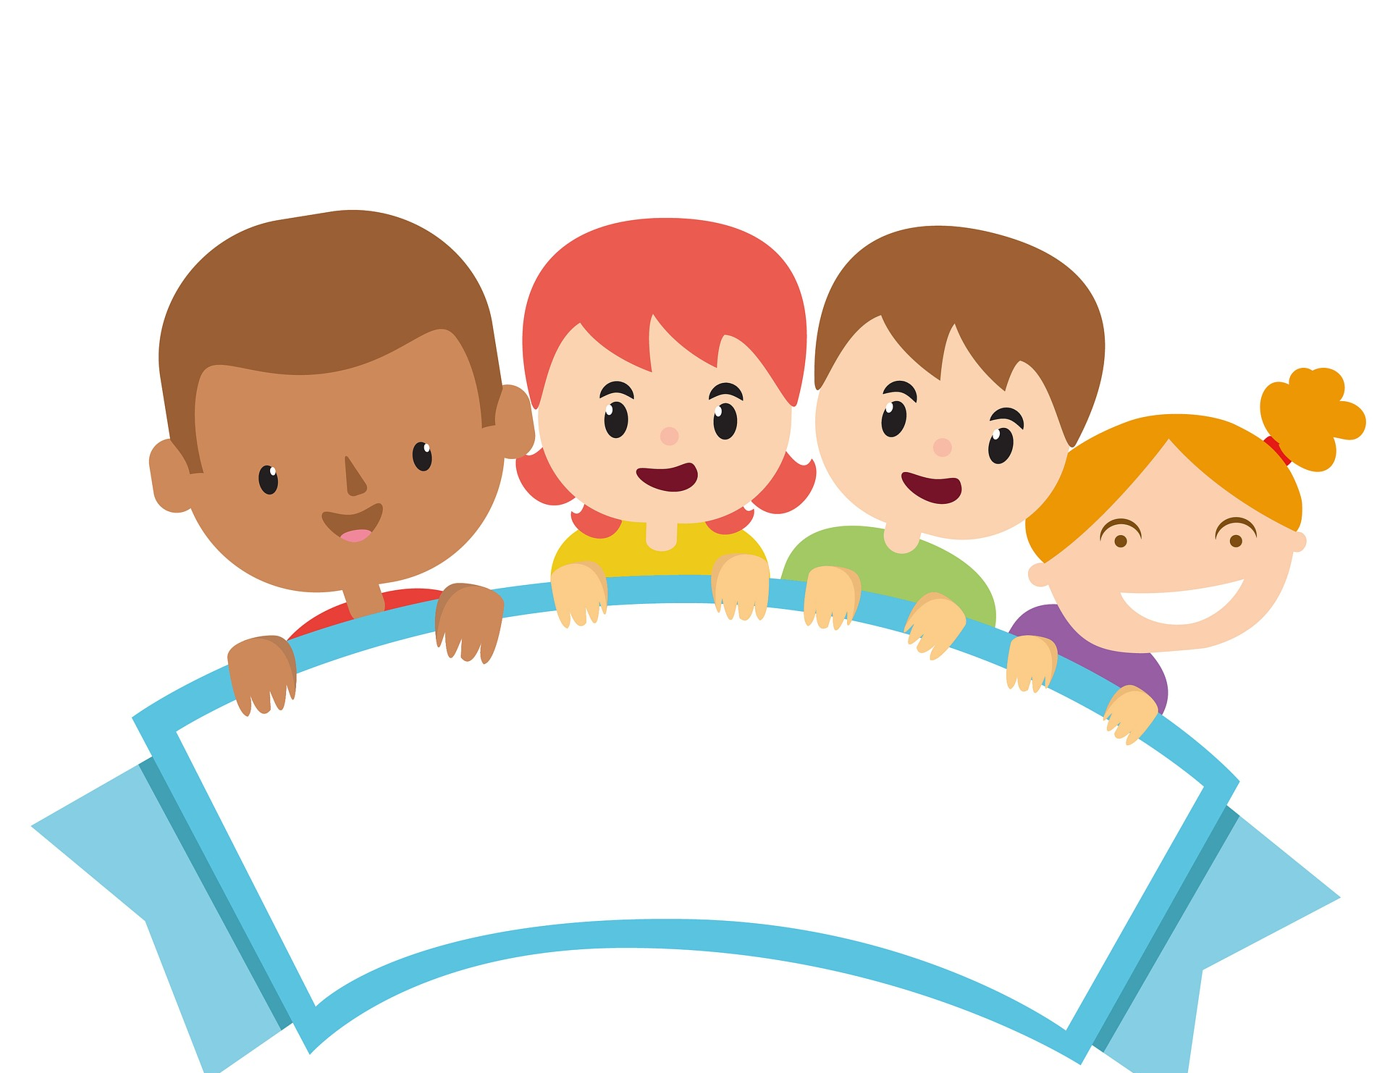
Introduction
Bunny’ s Needs | Class Needs
Who? | Who?
Notes:
Say: Let’s pretend we are JoZy. Everyone stand up and move in place like a kangaroo while I count to five.
Count out loud to five: 1, 2, 3, 4, 5! Everyone quickly sit back down.
Say: Now let’s pretend that JoZy has a pet bunny. Everyone stand up and move in place like a bunny while I count to five.
Count out loud to five: 1, 2, 3, 4, 5! Okay, everyone quickly sit back down.
On the chalkboard or a large piece of paper, draw two columns.
Write BUNNY’S NEEDS at the top of the left-hand column.
Ask: What are all the things that our bunny will need to live and be safe?
List their answers under BUNNY’S NEEDS in the left-hand column, such as a hutch, straw, food, water, exercise, attention, love or perhaps another animal for compay.
Under the NEEDS on the BUNNY side, write “WHO?”
Ask: Who is responsible to make sure that our pet gets to have his or her rights?
Write JOZY as the name of the BUNNY’S owner who is responsible for the bunny’s life.
Ask: Does the bunny really need these things to survive?
Should the bunny have a right to them?

Slide 11
Develop & Discuss
A RIGHT is like a ________ that exists because it is the _______________________.
Does the bunny have a right to the things it needs to survive?
Notes:
Who remembers what it means when we say it has a right? Someone tell us all again, what does the word “right” mean?
Explain: A right is like a rule that exists because it is the fair or the correct thing to do.

Slide 12
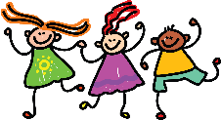
What do WE need to enjoy a happy, healthy, and safe life?
Who is responsible for helping us get the things we need to be safe and free?
Notes:
Ask: what do WE need to enjoy a happy, healthy and safe life?
List their responses under CLASS NEEDS in the right-hand column, helping to elicit such things as food, water, family, friends, education, love, clothes and attention.
Ask: If we need these things, then should we have a right to them?
Write: “Who” is responsible for helping us get all the things we need to be safe and free?
Encourage answers such as adults, parents, family, or loving caregivers.
List the response below the word “WHO?”

Slide 13
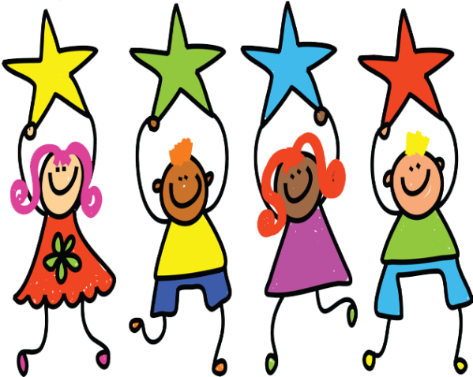
Conclusion
Notes:
READ: The Right to Be Free and Safe.
Say: I’ll read it one more time and then let’s all say it together. The Right to Be Free and Safe.
Repeat it together.
Say: Raise your hand for the Talking Stick of you can tell me what human rights are or if you know the name of the document that says what rights we have.

Slide 14
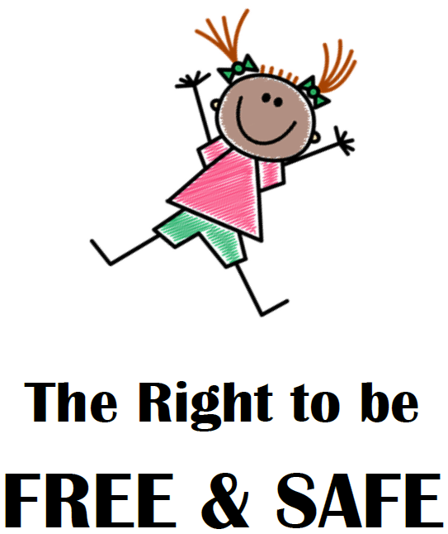
Notes:
Place the mini poster on the classroom wall or where all the children can see it.
read the poster to the children
Say: I’ll read it one more time and then let’s all say it together. The Right to Be Free and Safe.
Repeat it together.
Say: Raise your hand for the Talking Stick if you can tell me what human rights are or if you know the name of the document that says what rights we have.
Take all responses in a positive manner, especially the Universal Declaration of Human Rights. Elaborate on them and emphasize the right to be safe and free.

Slide 15
What Rights do You Have
Which right do you think is important for YOU to be safe and free?
Think about the Universal Declaration of Human Rights.
Notes:
Which right do you think is important for YOU to be safe and free?
To help the children remember, you may show the illustrations for the Universal Declaration of Human Rights from the previous lesson.
If your class is not too big, let each child stand up and give a response if they wish. Otherwise, just choose a few children to give a response such as:
Articles 1, 2 & 3: We are all born free and equal in dignity and rights.
We all have the right to live and be protected.
Article 16: We all have the right to a family and to be cared for.
Article 18: We all have the right to a religion or belief.
Article 19: We all have the right to tell people what we’re thinking about.
Article 29: We all need to take care of each other.
Article 30: Nobody can take these rights away from us.

Slide 16
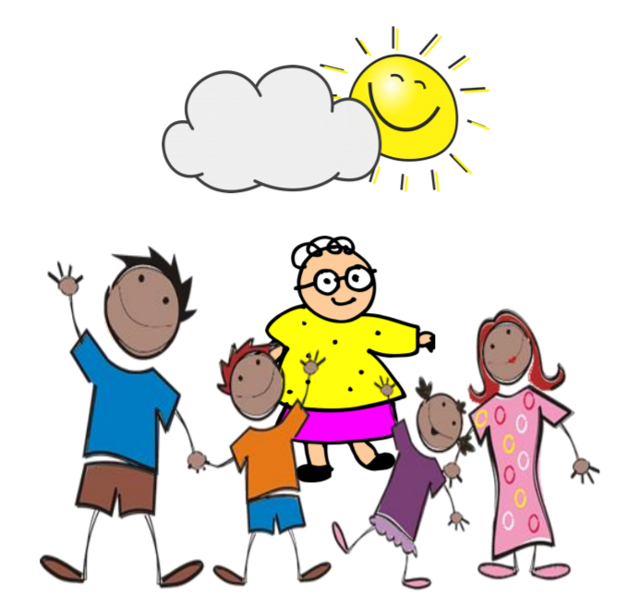
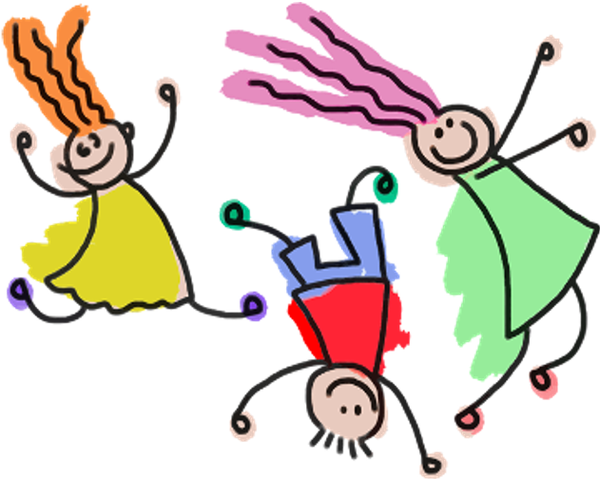
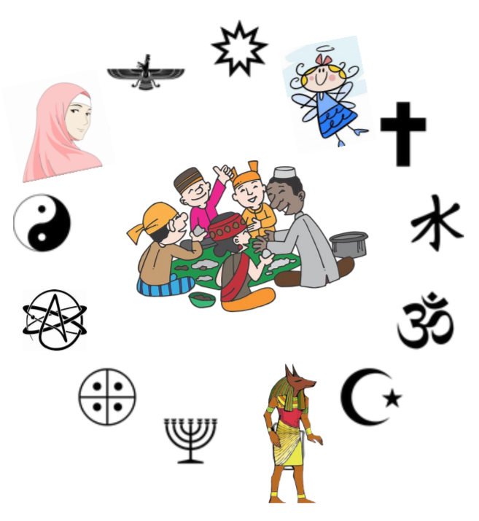
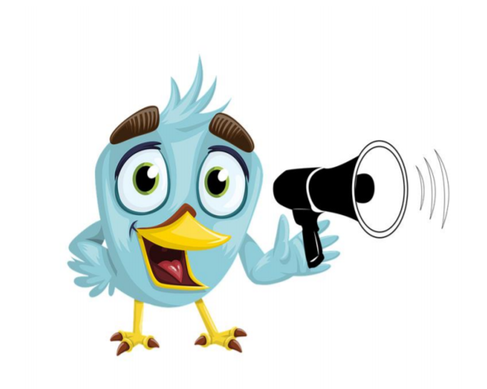
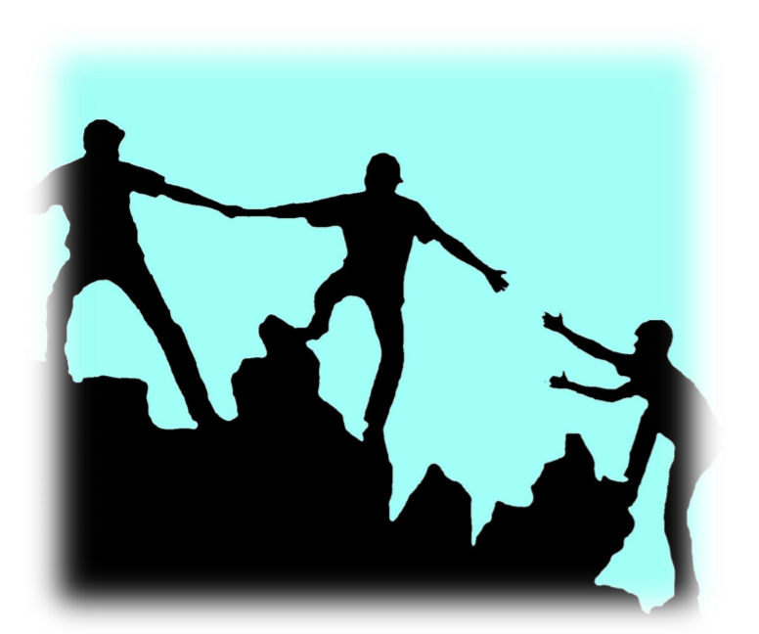
What Rights do You Have?
Notes:
Which right do you think is important for YOU to be safe and free?
To help the children remember, you may show the illustrations for the Universal Declaration of Human Rights from the previous lesson.
If your class is not too big, let each child stand up and give a response if they wish. Otherwise, just choose a few children to give a response such as:
Articles 1, 2 & 3: We are all born free and equal in dignity and rights.
We all have the right to live and be protected.
Article 16: We all have the right to a family and to be cared for.
Article 18: We all have the right to a religion or belief.
Article 19: We all have the right to tell people what we’re thinking about.
Article 29: We all need to take care of each other.
Article 30: Nobody can take these rights away from us.

Slide 17
Learning Points
We need human rights for children to live in freedom and safety.
Human needs and human rights are connected.

Slide 18
Challenge
Tell your family and friends about our bunny and her needs.
Think about a pet you might want to have and its needs.
Notes:
Say: Go home and tell your family and friends about our bunny and her needs.
Think about a pet you might want to have and what its need might be.
Are they the same as yours?
I’m so glad we were together today. Next time we will learn more about our rights.

Slide 20
References
1 | Visit the United Nations Geneva Office on Human Rights Education website to download and print lesson resources at www.go-hre.org
2 | United Nations Universal Declaration of Human Rights. https://www.un.org/en/universal-declaration-human-rights/
3 | United Nations Convention on the Rights of the Child. https://www.ohchr.org/en/professionalinterest/pages/crc.aspx

Slide 21
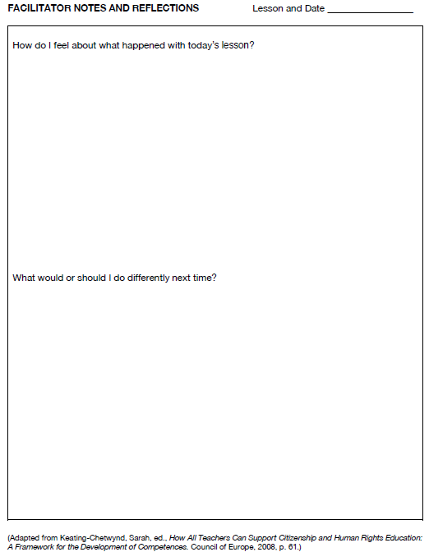
Resources

Slide 22
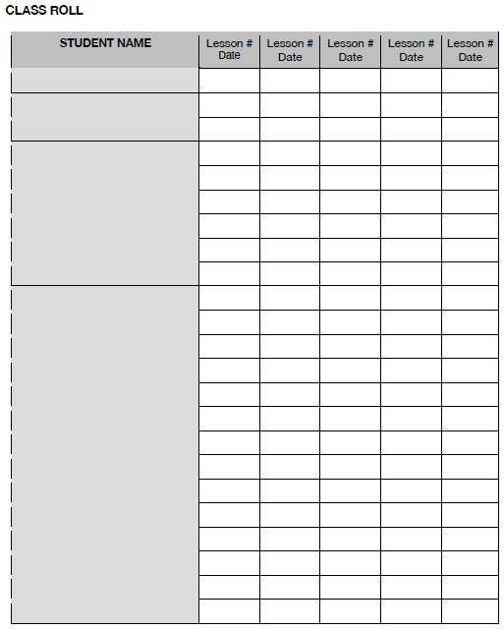
Resources

Slide 23
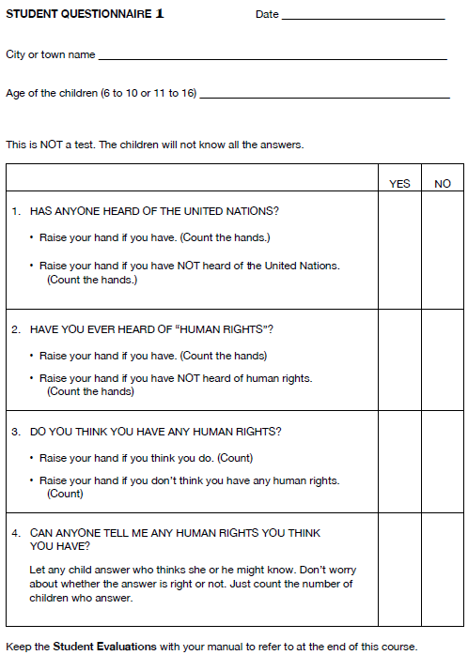
Resources

Slide 24
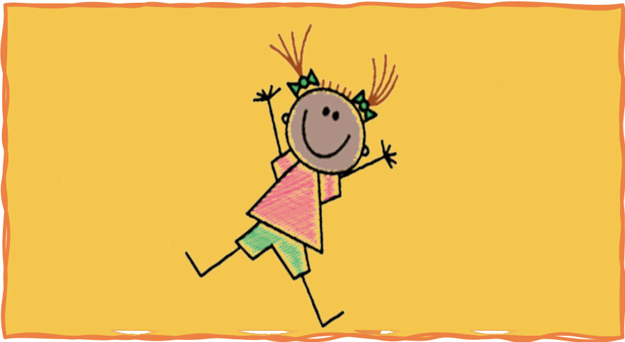
Colega
I Have Rights! Lesson 2B
Geneva Office of Human Rights Education

