Slide 2
Facilitator Tips
1 | Play “I’ll Walk With You” Activity Again | Let children recall what they have learned about discrimination.
2 | Prepare for “Concentration on the Family” Activity | Read about the activity before the class so you understand how to do the activity.
3 | Talking Stick | Use talking stick when students want to say something in a group, or, if the group is large, hold it up as a symbol to remind the children to take turns and listen respectfully when someone speaks.
4 | Write Down Notes and Reflections | Don't forget to fill out the notes and reflections section

Slide 3
Materials Needed
1 | Talking Stick
2 | Class Roll
3 | Class Rules Chart
4 | Chalkboard or Flipchart and chalk or Markers
5 | Facilitator Notes and Reflections
6 | Documents: Universal Declaration of Human Rights, UDHR 16
7 | A Family image and two sets of family photographs
8 | Mini-poster “The Right to a Family”

Slide 4
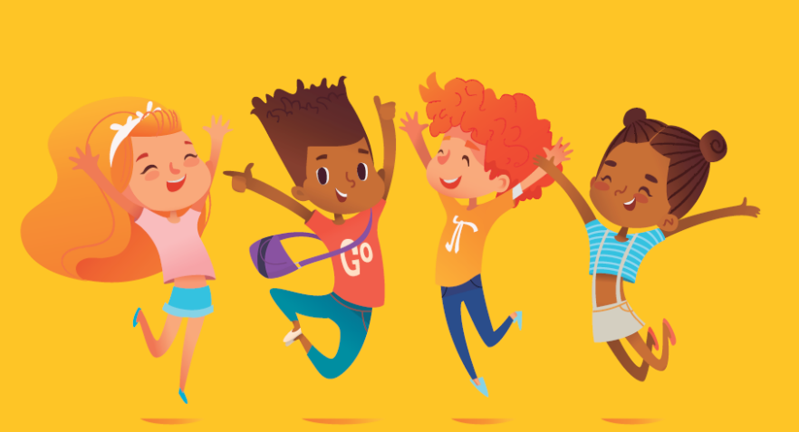
Family A Beautiful Thing 1 Lesson 4A
The Right to a Family

Slide 5
Welcome and Warm Up
Notes:
WELCOME and WARMUP(5 minutes)
Greet each child enthusiastically upon arrival, and show her or him where to sit. Briefly introduce yourself and tell the children how happy and excited you are to be starting this course about human rights. Explain that you love human rights and that they will, too.

Slide 6
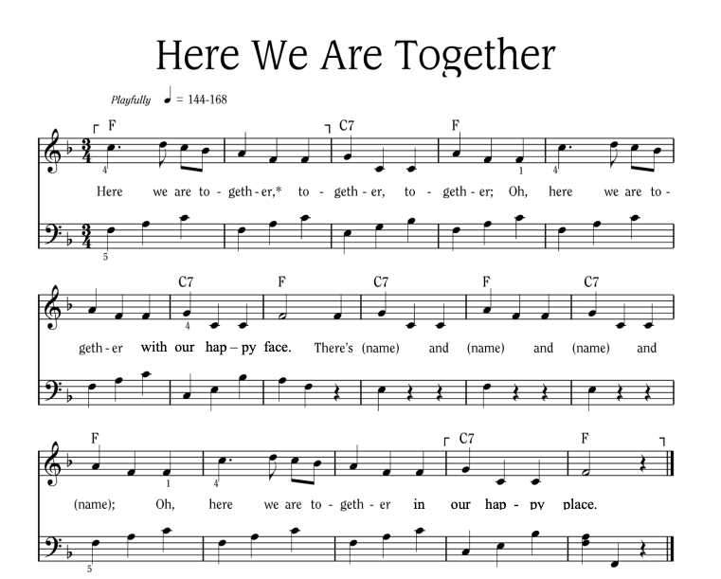
Notes:
Sing “Here We Are Together”
Sing the verse on your own, naming four different students. Point to the students and smile as you name them.
Repeat the song several times so that you can name many students.
To hear the melody:
To hear the melody: https://www.youtube.com/watch?v=XR9d7TsgQN8&list=PL1p11lCKMm7vUpyDMd39yUSVUUwUJ-Wa5&index=1
Sing with enthusiasm and delight.
Everyone: Here we are together, together, together. Here we are together with our happy face.
Facilitator: There’s Martha and Peter and Suzie and Henry (pointing to each of these children, one by one)
Everyone: Oh, here we are together in our happy place.
Sing the verse at least two or three times in a row so that you can name a few different children during each class.
Alternate Words:
Here we go a-walking
Here we are a-singing
Here we go a-marching
Here we are a-clapping
Make up actions based on the words! And you can make up your own words. Think of other phrases that might fit the music.

Slide 7
Here We Are Together
All
Here we are together, together, together,
Here we are together, with our happy face.
Teacher
There’s _________ and _________ and _________ and _________!
All
Oh, here we are together in our happy place!
Notes:
Sing “Here We Are Together”
Sing the verse on your own, naming four different students. Point to the students and smile as you name them.
Repeat the song several times so that you can name many students.
Everyone: Here we are together, together, together. Here we are together with our happy face.
Facilitator: There’s Martha and Peter and Suzie and Henry (pointing to each of these children, one by one)
Everyone: Oh, here we are together in our happy place.
Alternate Words:
Here we go a-walking
Here we are a-singing
Here we go a-marching
Here we are a-clapping
Make up actions based on the words! And you can make up your own words. Think of other phrases that might fit the music.

Slide 8
I’ll Walk with You
If you don’t walk as most people do,
Some people walk away from you,
But I won’t! I won’t!
If you don’t talk as most people do,
Some people talk and laugh at you,
But I won’t! I won’t!
I’ll walk with you.
I’ll talk with you.
That’s how I’ll show my love for you.
Notes:
(5 minutes)
Activity: I'll Walk with You (Music and words at the back of the lesson)
Say: Remember the poem (or song) we learned last time? I'll say (or sing) it first and then let's say it all together with the motions.
Facilitator: Point to the children and say, "If you don't walk as most people do ... " Shrug your shoulders, palms up: "Some people walk away from you." Wag your finger to signal "No" and say: "But I won't, I won't!"
Say: Okay, now let's say it all together with the motions.
If you don't walk as most people do, Some people walk away from you. But I won't! I won't!
Ask: Remember the next verse?
If you need help to tie your shoe (point to your foot) Some people won't be there for you.
Say: Okay, all together now.
If you need help to tie your shoe (point to your foot) Some people won't be there for you.
But I will! I will!
Say: I'll walk with you, I'll talk (wait for the children) ... with ... you.
That's how I'll show ... (wait for the children to remember) ... my love for you.
Say: Well done! Somebody tell me the word we use to describe how some people treat other people who have disabilities or who are different than we are? (Discrimination.)

Slide 9
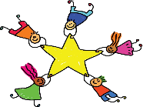
Learning Points
The family is the basic unit of society.
We each have the right to live with our family.
Families usually make us stronger no matter what they look like.
If our family is not a safe place, we each have a right to help and protection.
Notes:
The family is the basic unit of society.
We each have the right to live with our family.
Family units usually make us stronger no matter what their make-up or configuration.
If our family is not a safe place, we each have a right to help and protection.

Slide 10
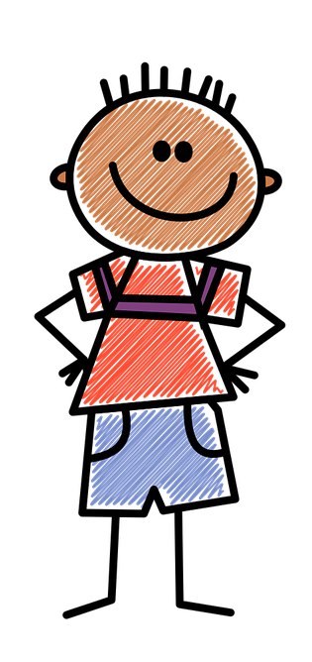
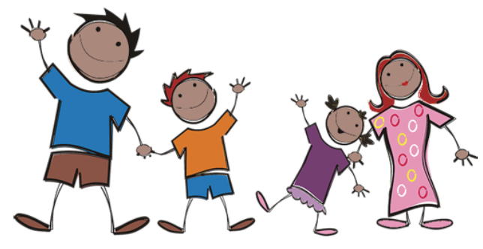
Family
Notes:
(10 minutes)
Show the picture of a family and say: Let's talk about another right.
Ask: What do we see here in this picture? (A family.)
Does everyone have to live in the same kind of family? (No.)
What kind of family do you have? (Give 3 or 4 children some time to describe their families.)

Slide 11
Concentration on the Family
Notes:
Before class, cut out all the pictures of both sets of the "Family Photographs." Trim as necessary to make them all the same size.
Explain: Not all children live in the same kind of families.
• Some live in a family with a mother and a father, others just have one mom or one dad or they're adopted or they live with two moms or two dads, and some kids even live with their grandparents. Some live in India or Japan or Great Britain. There are all kinds of families all over the world.
Show the various cards as you name different families. (Single Mom, Grandparents and Children, Conventional Family, etc.)
Say: We're going to play a game called "Concentration on the Family," and let's see if we can match up different kinds of families.
How to Play: Divide the children into two new groups or teams, combining the girls and the boys.
Give each child a number: one, two, one, two, one, two - until they all have a number. Put all the "ones" in one group, and all the "twos" in the other group.
Using both sets of cards, mix them up and lay them face down on a table or flat surface.
The first player on Team A begins the game by turning over one card and naming the picture on the card (such as Single Dad, Grandparents and Children, etc.).
The player turns over a second card, names the picture, and determines if the two cards match. If they match, Team A keeps the pair of cards. If they do not match, the first player turns the cards back over. The first player on Team B takes a turn looking for a pair of family cards, following the same directions as the previous player. If he or she gets a match, the team keeps the pair. If not, the player turns the cards back over.
The remaining players each take a turn looking for pairs of picture cards. The players on both teams cannot help the child who is choosing the cards.
Remind the children to pay close attention to where the cards are when a player does not get a match.
The team with the most matches at the end of the game wins!

Slide 12
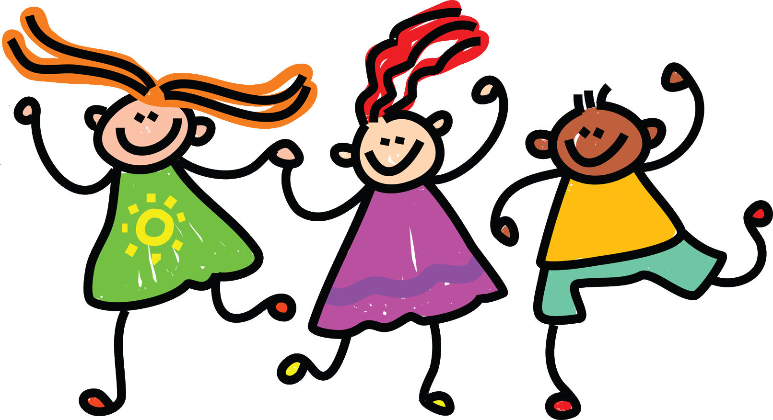
Develop and Discuss
The family is the fundamental part of society and government should protect it.
Notes:
Ask: Do we all have to come from the same kind of family in order to be happy and safe? (No.)
Explain: Families are important no matter what they look like. The people who wrote the Universal Declaration of Human Rights also said that families are important for children.
Let’s read a really important article in the declaration and see what it says.
I’m going to read and I want you to listen for a big word. It may start with the letter F.
Raise your hand when you hear it.
Read the last part of Article 16, pictured on this slide, emphasizing the word “fundamental” as you say it.
Ask: What was the word? (Fundamental.)
Let’s all repeat it.
What does the word fundamental mean?
Explain: “Fundamental” means that it’s the foundation, the most important part of society.
Let’s read that again and change the word “fundamental” to “most important”.
Repeat after me: The family is the most important part of society and the government should protect it.

Slide 13
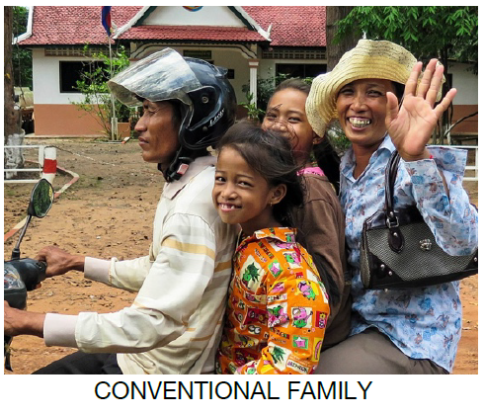
Families
What type of family
is this?
Notes:
Ask: What type of family is this?

Slide 14
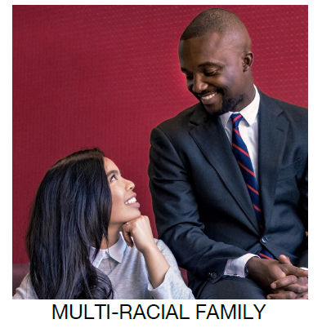
Families
What type of family
is this?
Notes:
Ask: What type of family is this?

Slide 15
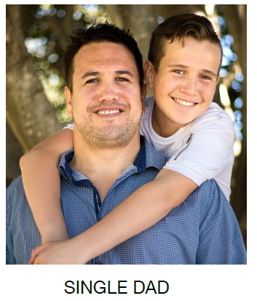
Families
What type of family
is this?
Notes:
Ask: What type of family is this?

Slide 16
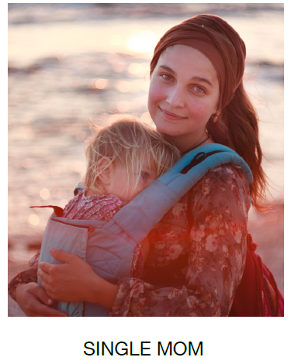
Families
What type of family
is this?
Notes:
Ask: What type of family is this?

Slide 17
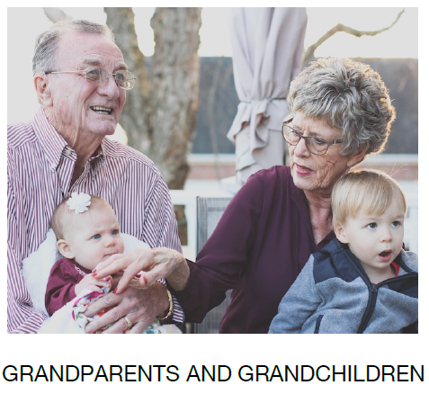
Families
What type of family
is this?
Notes:
Ask: What type of family is this?

Slide 18
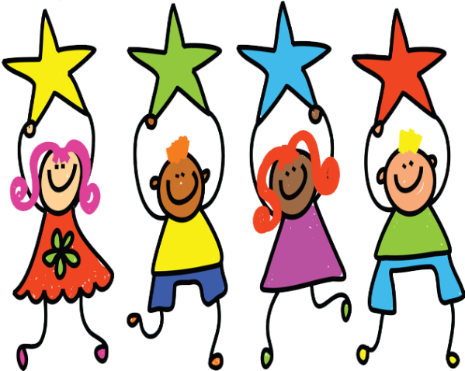
Conclusion
The family is the most important part of society!
Notes:
Say: Let’s say it all together one last time:
The family is the most important part of society and government should protect it.

Slide 19
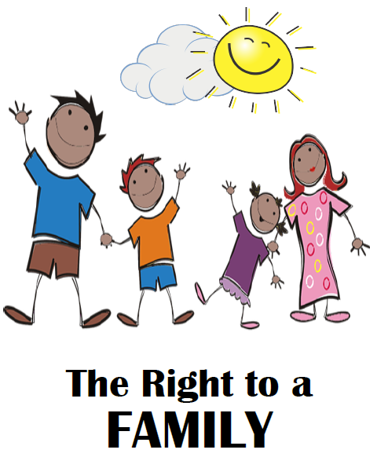
Notes:
SAY: Congratulations! The family really is a beautiful thing!

Slide 20
Learning Points
The family is the basic unit of society.
We each have the right to live with our family.
Families usually make us stronger no matter what they look like.
If our family is not a safe place, we each have a right to help and protection.
Notes:
The family is the basic unit of society.
We each have the right to live with our family.
Family units usually make us stronger no matter what their make-up or configuration.
If our family is not a safe place, we each have a right to help and protection.

Slide 21
Challenge
What does the word “fundamental” mean?
It means the foundation and the most important part of society.
Share the new word with your family and tell them how important they are you.
Notes:
Ask: What does the word “fundamental” mean? Yes! The most important part of society. Very good!
Say: Be sure and share your new word with your family. Fundamental. What a good word!
Have a great week! Tell your family how important they are.

Slide 23
References
1 | Visit the Geneva Office on Human Rights Education website to download and print lesson resources at www.go-hre.org
2 | United Nations Universal Declaration of Human Rights. https://www.un.org/en/universal-declaration-human-rights/
3 | United Nations Convention on the Rights of the Child. https://www.ohchr.org/en/professionalinterest/pages/crc.aspx

Slide 24
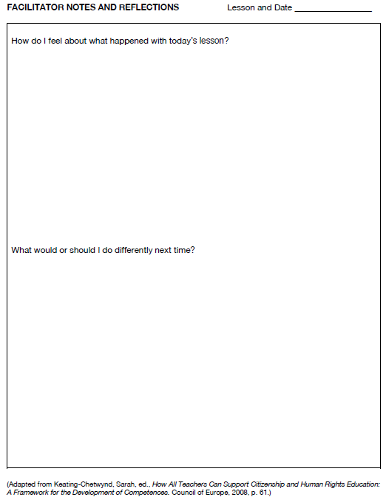
Resources

Slide 25
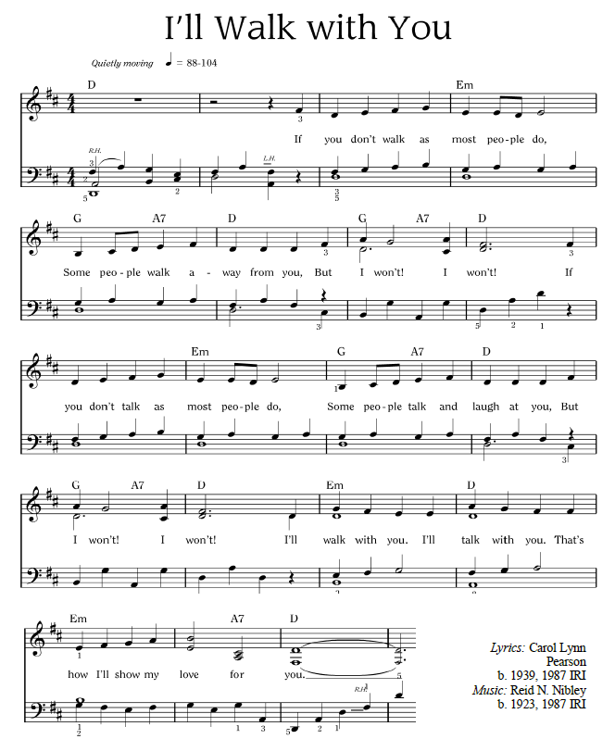
Resources

Slide 26
I’ll Walk with You
If you don’t walk as most people do,
Some people walk away from you,
But I won’t! I won’t!
If you don’t talk as most people do,
Some people talk and laugh at you,
But I won’t! I won’t!
I’ll walk with you.
I’ll talk with you.
That’s how I’ll show my love for you
Resources
Notes:
Sing “I’ll Walk With You”
Link for the song is here https://www.youtube.com/watch?v=2FNGVywm1rM&list=PL1p11lCKMm7vUpyDMd39yUSVUUwUJ-Wa5&index=2

Slide 27
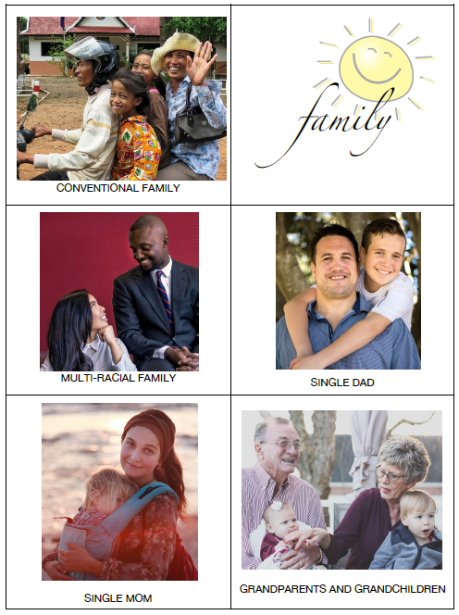
Resources

Slide 28
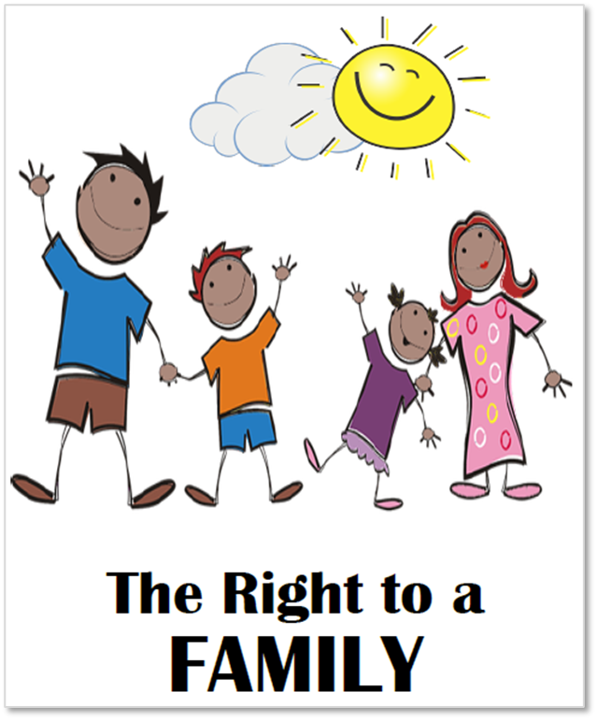
Resources

Slide 29
Universal Declaration on Human Rights Article 16
You have the right to marry and start a family. Nobody should force you to marry.
The family is the fundamental unit of society, and government should protect it.
Resources

Slide 30
Convention on the Rights of the Child Article 9
You have the right to be brought up by your parents unless it is not safe or not possible.
Resources

Slide 31
Convention on the Rights of the Child Article 20
You have the right to special protection and help if you can’t live with your parents.
Resources

Slide 32
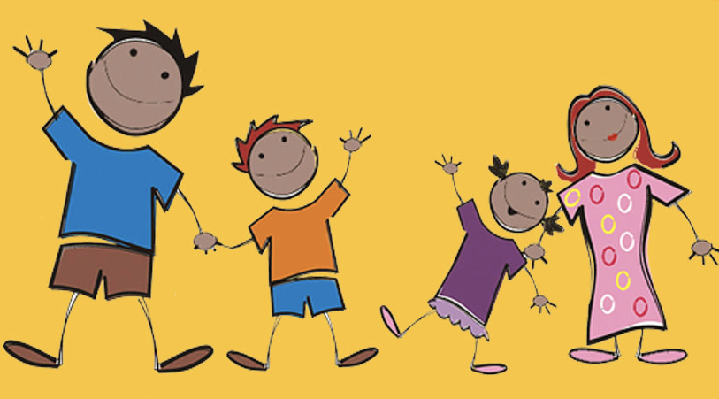
Colega
Family A Beautiful Thing 1 Lesson 4A
Geneva Office of Human Rights Education

