Slide 2
Facilitator Tips
1 | Prepare for the “My Family” Activity | Emphasize tolerance, feelings and values which make a family stronger during this activity
2 | Prepare for the Laundry Activity | Make sure that all of the children have a chance to be the “laundry” during the first few months of class
3 | Talking Stick | Use talking stick when students want to say something.
4 | Write Down Notes and Reflections | Don't forget to fill out the notes and reflections section

Slide 3
Materials Needed
1 | Talking Stick
2 | Class Roll
3 | Class Rules Chart
4 | Chalkboard or Flipchart and chalk or Markers
5 | Facilitator Notes and Reflections
6 | Document: Universal Declaration of Human Rights, UDHR 16
7 | Document: Convention on the Rights of the Child Articles 9 & 20
8 | Mini-posters from previous lessons
9 | Paper for children to draw on
10 | A Family Image

Slide 4
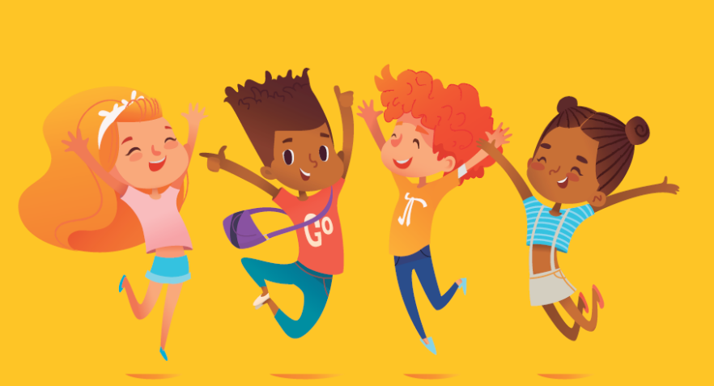
Love at Home 1 Lesson 5B
The Right to a Family

Slide 5
Welcome and Warm Up
Notes:
WELCOME and WARMUP(5 minutes)
Greet each child enthusiastically upon arrival, and show her or him where to sit. Briefly introduce yourself and tell the children how happy and excited you are to be starting this course about human rights. Explain that you love human rights and that they will, too.

Slide 6
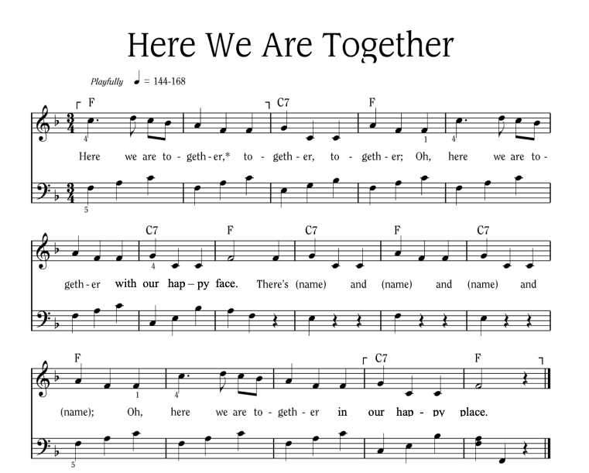
Notes:
Sing “Here We Are Together”
Sing the verse on your own, naming four different students. Point to the students and smile as you name them.
Repeat the song several times so that you can name many students.
To hear the melody:
To hear the melody: https://www.youtube.com/watch?v=XR9d7TsgQN8&list=PL1p11lCKMm7vUpyDMd39yUSVUUwUJ-Wa5&index=1
Sing with enthusiasm and delight.
Everyone: Here we are together, together, together. Here we are together with our happy face.
Facilitator: There’s Martha and Peter and Suzie and Henry (pointing to each of these children, one by one)
Everyone: Oh, here we are together in our happy place.
Sing the verse at least two or three times in a row so that you can name a few different children during each class.
Alternate Words:
Here we go a-walking
Here we are a-singing
Here we go a-marching
Here we are a-clapping
Make up actions based on the words! And you can make up your own words. Think of other phrases that might fit the music.

Slide 7
Here We Are Together
All
Here we are together, together, together,
Here we are together, with our happy face.
Teacher
There’s _________ and _________ and _________ and _________!
All
Oh, here we are together in our happy place!
Notes:
Sing “Here We Are Together”
Sing the verse on your own, naming four different students. Point to the students and smile as you name them.
Repeat the song several times so that you can name many students.
Everyone: Here we are together, together, together. Here we are together with our happy face.
Facilitator: There’s Martha and Peter and Suzie and Henry (pointing to each of these children, one by one)
Everyone: Oh, here we are together in our happy place.
Alternate Words:
Here we go a-walking
Here we are a-singing
Here we go a-marching
Here we are a-clapping
Make up actions based on the words! And you can make up your own words. Think of other phrases that might fit the music.
Alternate phrases: Here we go a-walking, Here we are a-singing, Here we go a-marching, Here we are a-clapping…etc. Improvise actions as suggested by the words.
The list above is only a few of the possibilities.
Consider other phrases that might fit the music and the occasion.

Slide 8
Review
Laundry Game Activity
Use words of praise and encouragement.
Notes:
(5 minutes)
Say: Last week we played the Laundry game that made us feel happy when we heard kind words of praise and encouragement and love.
Ask: Does anyone want to tell us what you did to make someone in your family happy?

Slide 9
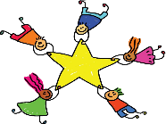
Learning Points
The family is the basic unit of society.
We each have the right to live with our family.
Families usually make us stronger no matter what they look like.
Notes:
The family is the basic unit of society.
We each have the right to live with our family.
Family units usually make us stronger no matter what their make-up or configuration.

Slide 10
Universal Declaration on Human Rights Article 16
You have the right to marry and start a family. Nobody should force you to marry. The family is the basic unit of society, and government should protect it.
Notes:
Now listen to the Universal Declaration of Human Rights: Read Article 16.

Slide 11
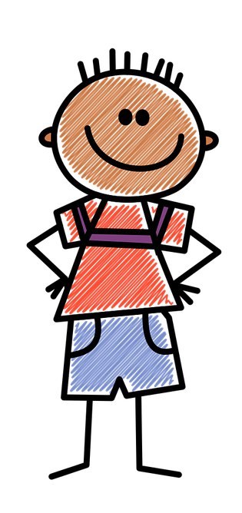
Johnny’s Family
How does your family take care of you?
Notes:
(5 minutes)
Point to the small boy. Explain: This is Johnny when he was a little boy.
Point to the parents: He had a family who loved him and took good care of him.
Ask: How does your family take care of you? (Allow 2 or 3 students to answer.)

Slide 12
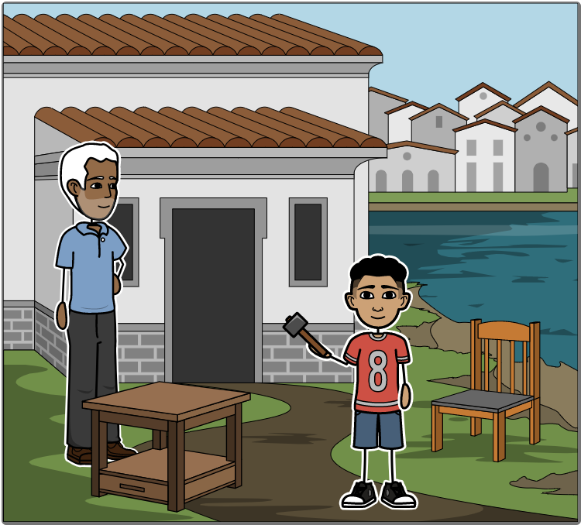
Notes:
Explain: Johnny's father often took him to work in the wood shop with him. He taught Johnny how to smooth the wood and make things from it.

Slide 13
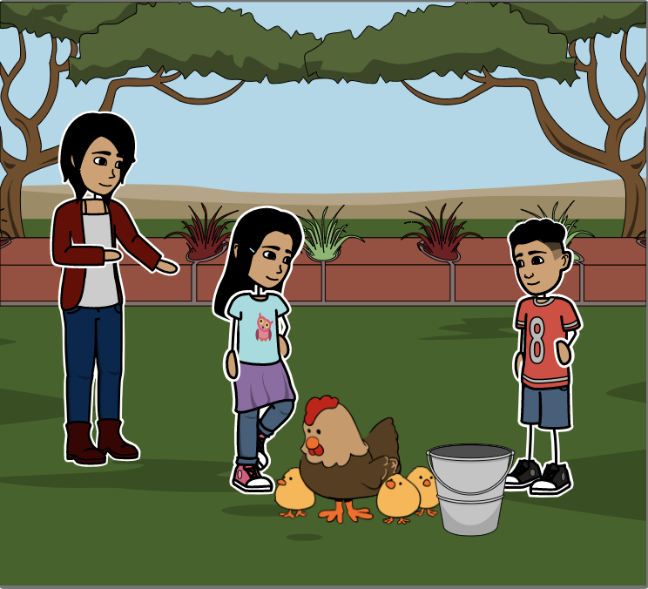
Notes:
Johnny's mother taught him and his sisters how to feed the chickens. There were many family chores to do. But they all learned what needed to be done and they worked together.
When we help each other, there is more love in our families and we are happier and our families are stronger.

Slide 14
The 4-handed Chair
Grab your left wrist with your right hand.
Grab your partner’s right wrist with your left hand.
Grab the right wrist of your partner with your left hand.
Notes:
Explain: Let’s play a game that I think is really fun. I want you to see if you can figure out how it’s like a family.
Tip: If your class is very large, you may wish to have only two or three groups come to the front to demonstrate the activity.
Create groups of three children each. Make sure the third person (the passenger) is smaller than the two people who create the “chair”.
If there’s an extra person, that person could coach. Or two extras could take turns being a passenger in another group.
How to play:
Each child should grab his/her own left wrist with his/her right hand.
Each child should then grab her/his partner’s right wrist with her/his left hand. The facilitator should demonstrate this
The partner then grabs the right wrist of the other person with her/his left hand. This creates a square shaped seat with their arms.
When the pairs have each created a chair, they should let a third person sit on their “chair”.
The person (passenger) being picked up should first lower herself into a sitting position.
The “chair” pair should stand behind her and lower their bodies as well, bringing the chair down into position for the passenger to be seated.
The person then sits on the chair and puts her arms around the shoulders of the chair pair for ballance.
The chair pair slowly lifts together and walks forward carefully with the passenger.
If there’s time, and your class is not too big, give everyone a chance to be a chair as well as a passenger.
Tip: Make sure the children know this game is to only be played under adult supervision, as it could be dangerous.

Slide 15
Develop & Discuss
Was it easier or harder to carry someone with the help of another person? Why?
Did you feel stronger with another person?

Slide 16
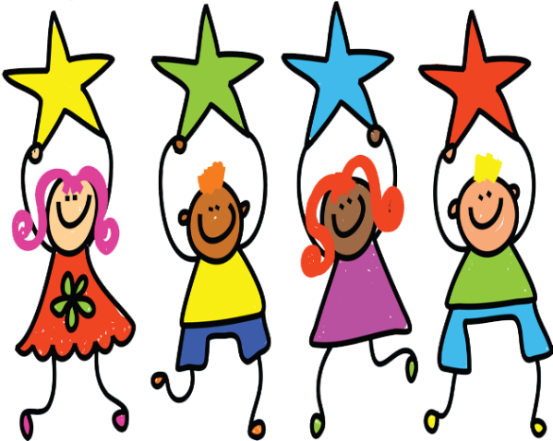
Conclusion
How is the four-handed chair like the family?
What do you think would happen if one of the chair people lost their grip?
Notes:
How is that like the family? (The family is stronger when we show love and help each other.)
What do you think would happen if one of the chair people lost their grip?

Slide 17
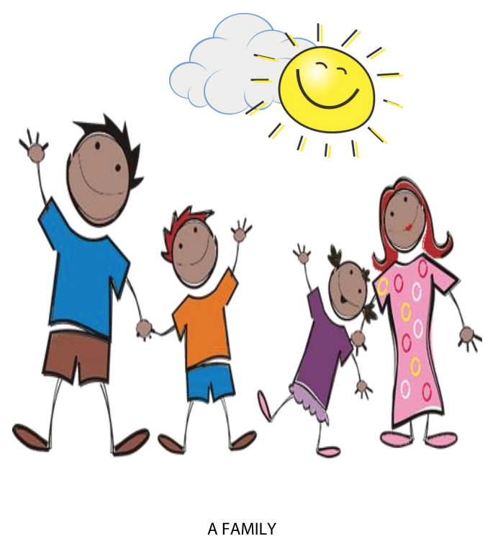
What would happen if the passenger started bouncing around or hitting the chair people?
If you didn’t feel safe, who could you talk to about safety?
Notes:
What would happen if the passenger started bouncing around or hitting the chair people?
If you didn’t feel safe, who could you talk to about safety (Another adult such as your mother or your leader at school or one of your friends.)
Why do you think families are the best place to grow up? (You have people who love you and keep you safe and show you how to do the right things.)

Slide 18
Why do you think families are the best place to grow up?
Notes:
Why do you think families are the best place to grow up? (You have people who love you and keep you safe and show you how to do the right things.)

Slide 19
Learning Points
The family is the basic unit of society.
We each have the right to live with our family.
Families usually make us stronger no matter what they look like.
Notes:
The family is the basic unit of society.
We each have the right to live with our family.
Family units usually make us stronger no matter what their make-up or configuration.

Slide 20
Challenge
Show your family how to make a four-handed chair and give someone a ride.
Have an adult nearby to make sure no one falls or is injured when you play the game.
Notes:
Say: Families are stronger when everybody works together.
Show your family how to make a four-handed chair and give someone a ride. Have an adult nearby to make sure no one fails or gets hurt.
Remind the children about the time for your next gathering.
Say: I can hardly wait to see you next time. Have a wonderful week!

Slide 22
References
1 | Visit the Geneva Office on Human Rights Education website to download and print lesson resources at www.go-hre.org
2 | United Nations Universal Declaration of Human Rights. https://www.un.org/en/universal-declaration-human-rights/
3 | United Nations Convention on the Rights of the Child. https://www.ohchr.org/en/professionalinterest/pages/crc.aspx

Slide 23
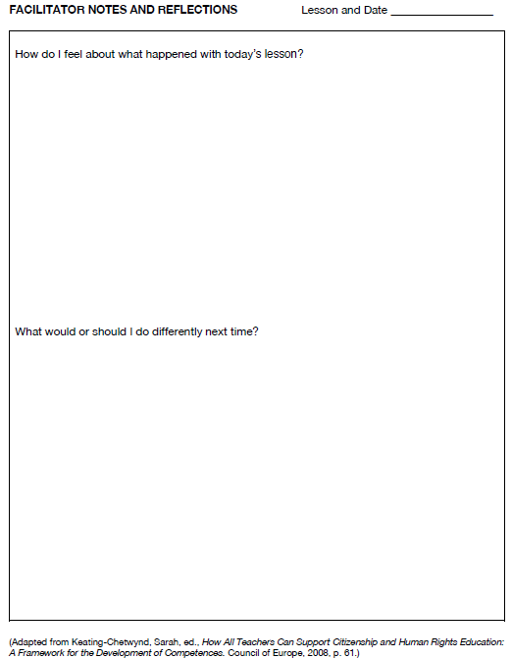
Resources

Slide 24
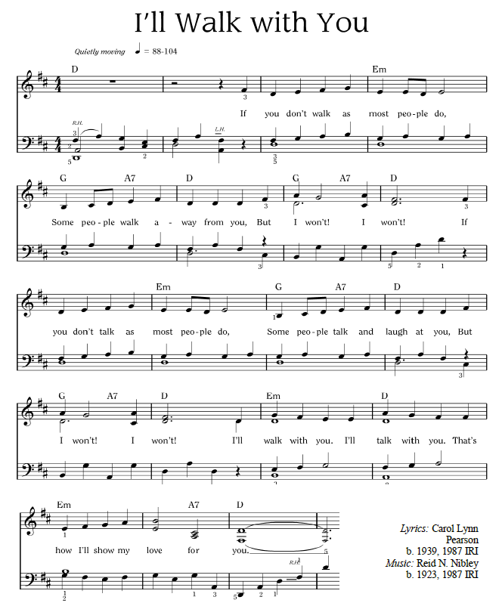
Resources

Slide 25
I’ll Walk with You
If you don’t walk as most people do,
Some people walk away from you,
But I won’t! I won’t!
If you don’t talk as most people do,
Some people talk and laugh at you,
But I won’t! I won’t!
I’ll walk with you.
I’ll talk with you.
That’s how I’ll show my love for you
Resources
Notes:
Sing “I’ll Walk With You”
Link for the song is here https://www.youtube.com/watch?v=2FNGVywm1rM&list=PL1p11lCKMm7vUpyDMd39yUSVUUwUJ-Wa5&index=2

Slide 26
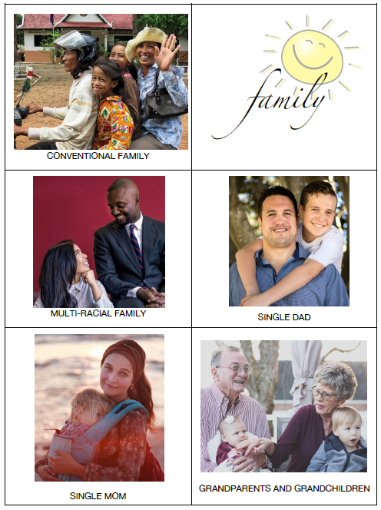
Resources

Slide 27
Resources

Slide 28
Universal Declaration on Human Rights Article 16
You have the right to marry and start a family. Nobody should force you to marry.
The family is the fundamental unit of society, and government should protect it.
Resources

Slide 29
Convention on the Rights of the Child Article 9
You have the right to be brought up by your parents unless it is not safe or not possible.
Resources

Slide 30
Convention on the Rights of the Child Article 20
You have the right to special protection and help if you can’t live with your parents.
Resources

Slide 31
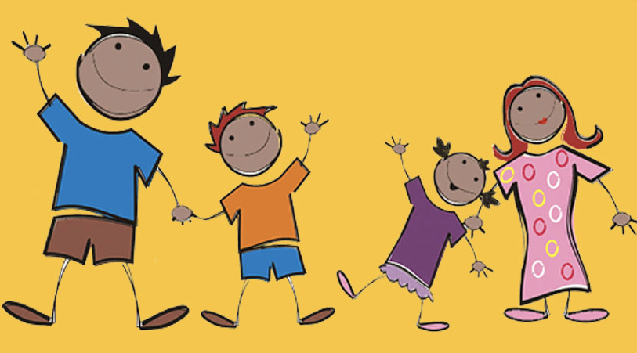
Colega
Love at Home 1 Lesson 5B
Geneva Office of Human Rights Education

