Slide 2
Facilitator Tips
1 | Prepare to tell the story of Peter and his brothers | Read and prepare to tell the story about Peter and his brothers. If you know the story and tell it from the memory, kids will be more engaged.
2 | Talking Stick | Have students use the talking stick when students want to say something.
3 | Write Down Notes and Reflections | Don't forget to fill out the notes and reflections section

Slide 3
Materials Needed
1 | Talking Stick
2 | Class Roll
3 | Class Rules Chart
4 | Chalkboard or Flipchart and chalk or Markers
5 | Facilitator Notes and Reflections
6 | Mini-poster “The Right to Freedom of Expression”
7 | Document: Convention on the Rights of the Child Article 13
8 | Like or Dislike Pictures
9 | Song “We are Different”

Slide 4
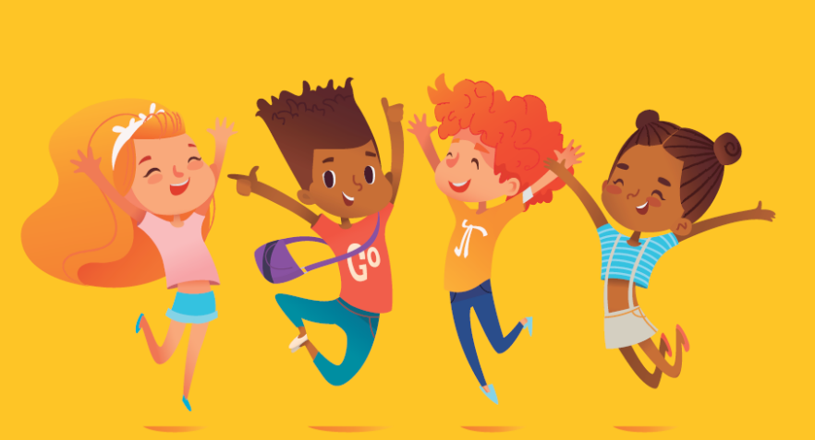
Words Make a Difference 1 Lesson 7A
Freedom of Expression

Slide 5
Welcome and Warm Up
Notes:
WELCOME and WARMUP(5 minutes)
Greet each child enthusiastically upon arrival, and show her or him where to sit. Briefly introduce yourself and tell the children how happy and excited you are to be starting this course about human rights. Explain that you love human rights and that they will, too.

Slide 6
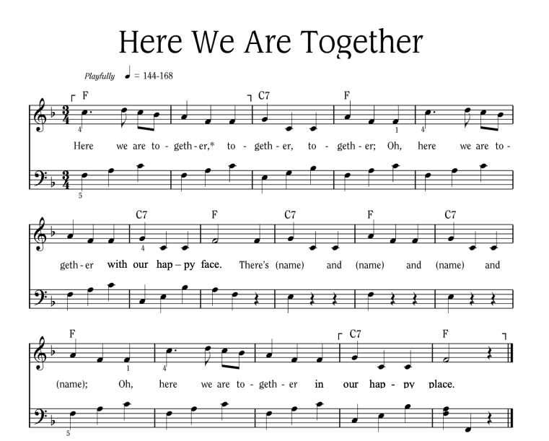
Notes:
Sing “Here We Are Together”
Sing the verse on your own, naming four different students. Point to the students and smile as you name them.
Repeat the song several times so that you can name many students.
To hear the melody:
To hear the melody: https://www.youtube.com/watch?v=XR9d7TsgQN8&list=PL1p11lCKMm7vUpyDMd39yUSVUUwUJ-Wa5&index=1
Sing with enthusiasm and delight.
Everyone: Here we are together, together, together. Here we are together with our happy face.
Facilitator: There’s Martha and Peter and Suzie and Henry (pointing to each of these children, one by one)
Everyone: Oh, here we are together in our happy place.
Sing the verse at least two or three times in a row so that you can name a few different children during each class.
Alternate Words:
Here we go a-walking
Here we are a-singing
Here we go a-marching
Here we are a-clapping
Make up actions based on the words! And you can make up your own words. Think of other phrases that might fit the music.

Slide 7
Here We Are Together
All
Here we are together, together, together,
Here we are together, with our happy face.
Teacher
There’s _________ and _________ and _________ and _________!
All
Oh, here we are together in our happy place!
Notes:
Sing “Here We Are Together”
Sing the verse on your own, naming four different students. Point to the students and smile as you name them.
Repeat the song several times so that you can name many students.
Everyone: Here we are together, together, together. Here we are together with our happy face.
Facilitator: There’s Martha and Peter and Suzie and Henry (pointing to each of these children, one by one)
Everyone: Oh, here we are together in our happy place.
Alternate Words:
Here we go a-walking
Here we are a-singing
Here we go a-marching
Here we are a-clapping
Make up actions based on the words! And you can make up your own words. Think of other phrases that might fit the music.
Alternate phrases: Here we go a-walking, Here we are a-singing, Here we go a-marching, Here we are a-clapping…etc. Improvise actions as suggested by the words.
The list above is only a few of the possibilities.
Consider other phrases that might fit the music and the occasion.

Slide 8
Alternate Words
Here we go a-walking
Here we are a-singing
Here we go a-marching
Here we are a-clapping
Make up actions based on the words!
And you can make up your own words.
Think of other phrases that might fit the music.

Slide 9
Review
Look at the poster on “The Right to Freedom of Religion or Belief.”
Did you notice any stereotypes being used since the last time we met?
What did you do when you heard a stereotype that was unkind or unfair?
Notes:
REVIEW (5 minutes)
Point to the mini poster on “The Right to Freedom of Religion or Belief.”
Ask: Did you notice any stereotypes being used since the last time we met?
• What did you do when you heard a stereotype that was unkind or unfair?
• Remember our song from last time? I’ll start us, and then let’s do it together.
• I know you, and you know me (show the actions).
• Okay, everybody, let’s sing together with the actions:
I know you and you know me, We are as different as the sun and the sea. I know you and you know me, And that’s the way it’s supposed to be.

Slide 11
Learning Points
Everyone has a right to say what they think.
There are limits to this right.
We are not free to say things that will hurt other people.
Notes:
SAY:
1. Remember, everyone has a right to say what they think. But there are limits to this right.
2. We are not free to say things that will hurt or endanger other people.

Slide 12
We Are Different
Make up actions!
1. I know you, and you know me. We are as different as the sun and the sea. I know you, and you know me. And that’s the way it’s supposed to be.
2. I help you, and you help me. We learn from problems, and we’re starting to see. I help you, and you help me. And that’s the way it’s supposed to be.
3. I love you, and you love me. We reach together for the best we can be.
I love you, and you love me. And that’s the way it’s supposed to be.
Notes:
VARIATION: You can have the children clap their hands in rhythm or come up with actions as they say the poem or sing the song.
We Are Different:
I know you, and you know me.
We are as different as the sun and the sea.
I know you, and you know me,
And that’s the way it’s supposed to be.
I help you, and you help me.
We learn from problems, and we’re starting to see.
I help you, and you help me,
And that’s the way it’s supposed to be.
I love you, and you love me.
We reach together for the best we can be.
I love you, and you love me,
And that’s the way it’s supposed to be.

Slide 13
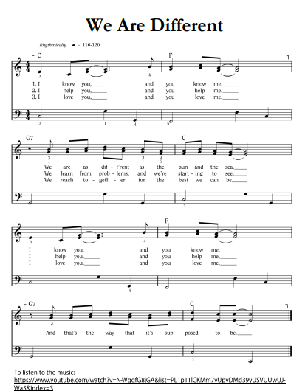
Notes:
VARIATION: You can have the children clap their hands in rhythm or come up with actions as they say the poem or sing the song.
We Are Different:
I know you, and you know me.
We are as different as the sun and the sea.
I know you, and you know me,
And that’s the way it’s supposed to be.
I help you, and you help me.
We learn from problems, and we’re starting to see.
I help you, and you help me,
And that’s the way it’s supposed to be.
I love you, and you love me.
We reach together for the best we can be.
I love you, and you love me,
And that’s the way it’s supposed to be.

Slide 14
Building a Boat
A story about Peter and his brothers…
Notes:
SAY: Let’s read the end of the story again:

Slide 15
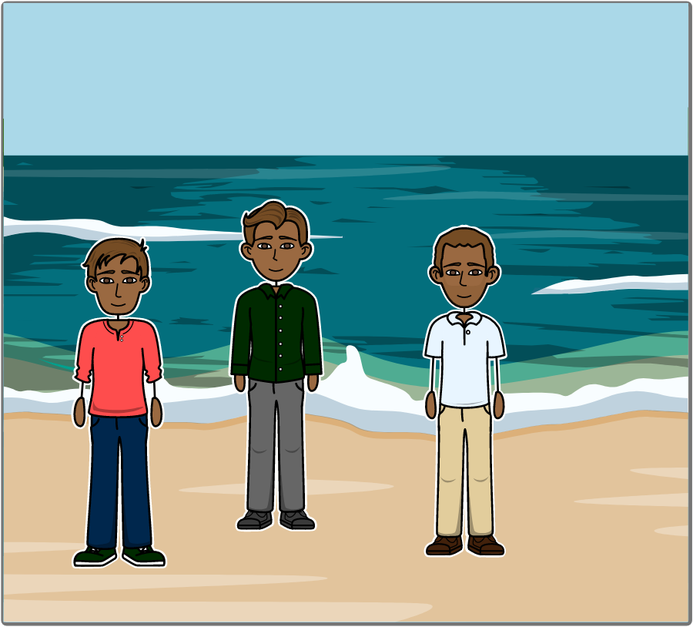
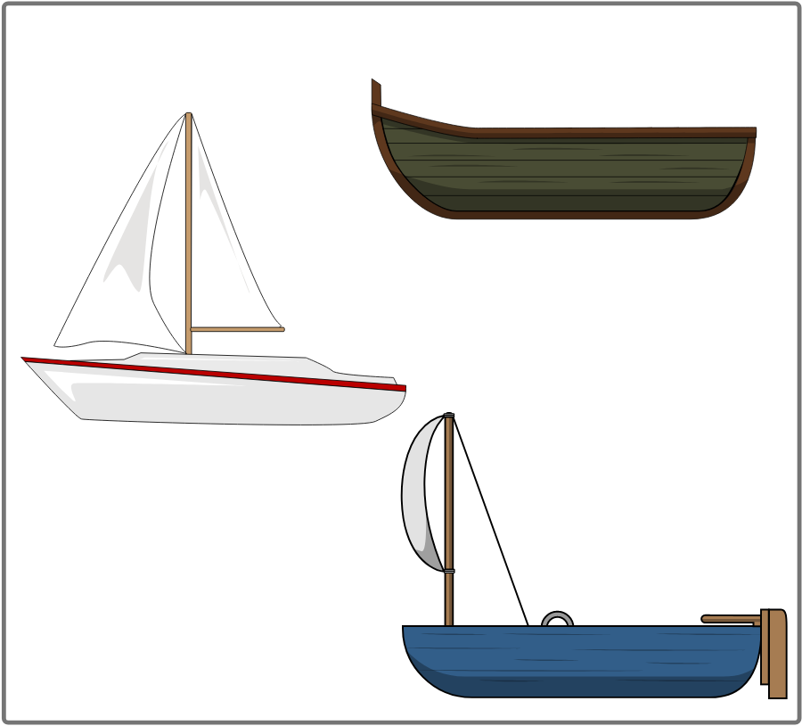
Once upon a time Peter and his two older brothers decided to make a boat. They all drew what they thought it should look like.
Notes:
Say: Everybody come closer. I’m going to tell you a story. Tell the story and show the pictures found at the end of the lesson. Once upon a time there was a little boy named Peter. He had two older brothers named Jack and Matt. They all decided to build a big boat. They got hammers and nails and wood. Then they all drew pictures of what the boat should look like. Each picture was different.

Slide 16
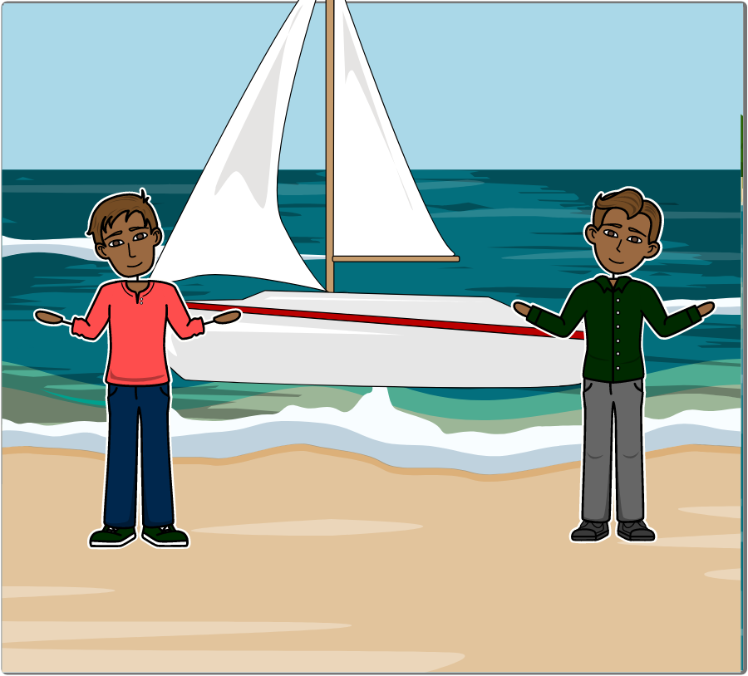
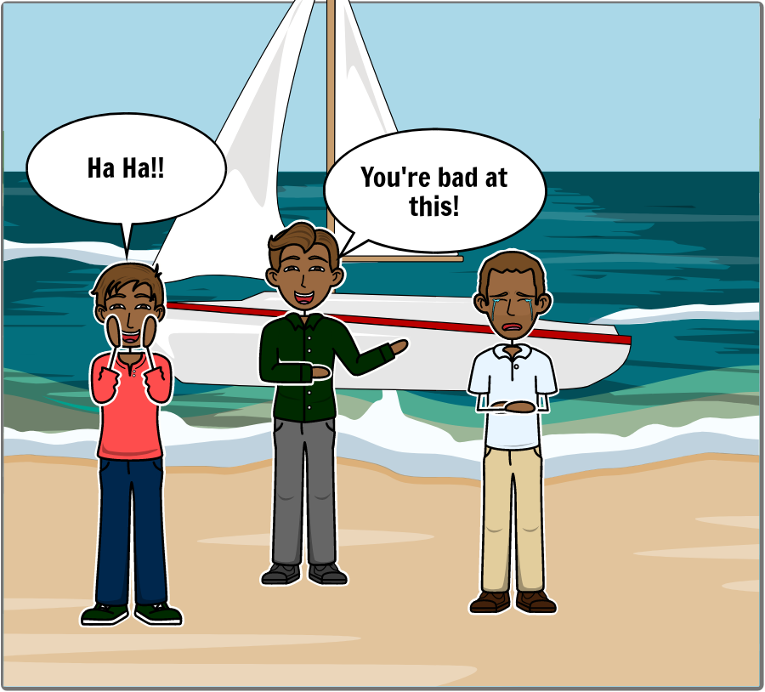
Each picture was different. Peter’s brothers didn’t like his picture, so they built a different boat and made fun of him. He began to cry.
Notes:
Jack didn’t like Peter’s picture. He liked Matt’s picture instead. So Jack and Matt decided to build the boat like Matt’s picture. They began making fun of Peter. They told Peter he was dumb. “You’re too little to draw a good picture,” they said. Peter felt bad. He started to cry.

Slide 17
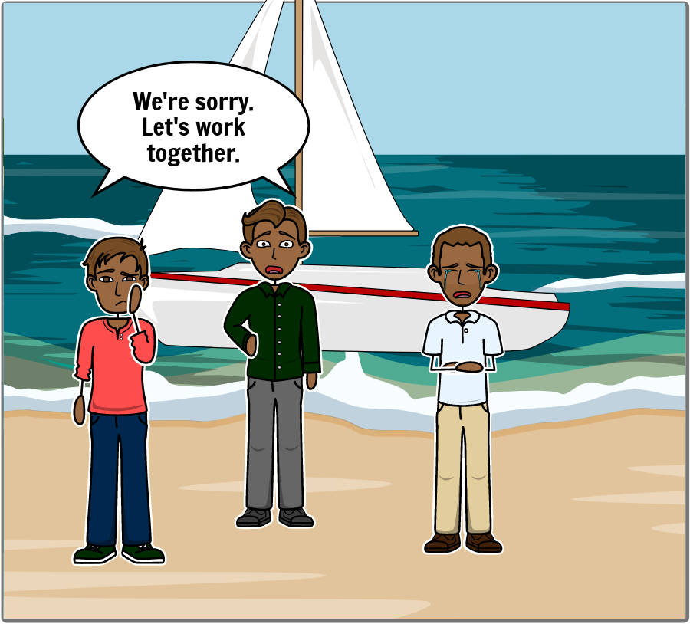
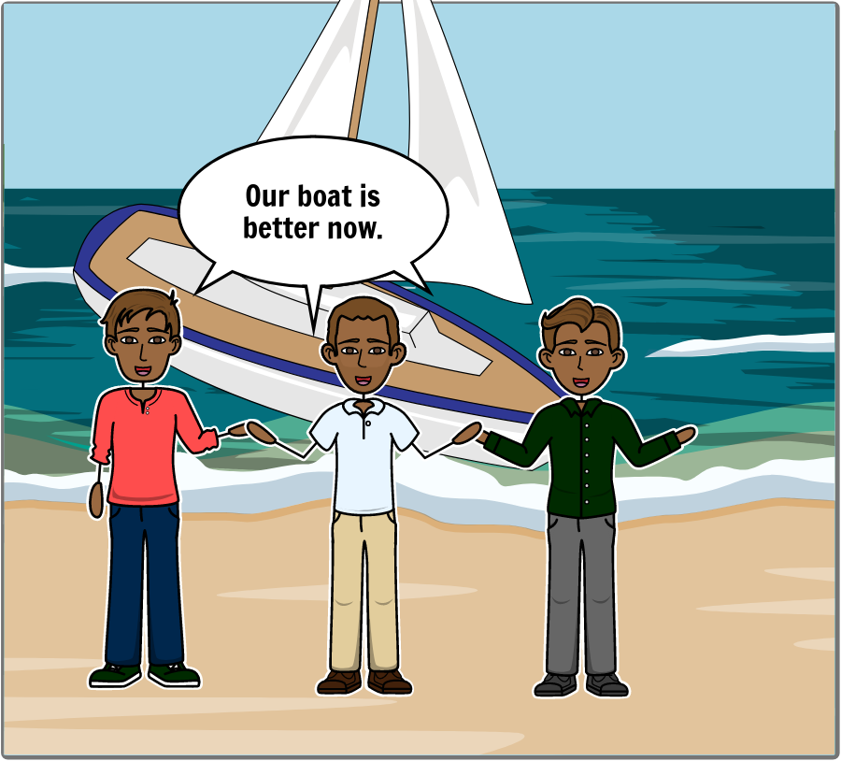
When Peter’s brothers saw that he was upset, they felt bad and said they were sorry. They worked together to build an even better boat, using all of their ideas.
Notes:
Then Jack and Matt felt bad when they saw how sad Peter was. They told him they were sorry. They all looked at their pictures again. They decided they could use Peter’s picture for the side of the boat and Matt’s picture for the rest of the boat. Everyone was happy as they were building their new boat together.

Slide 18
How did Jack and Matt make Peter feel?
Why was Peter sad?
Have you ever been sad?
What made you sad?
Why did Peter feel happy later?
How do you feel when your friends let you play with them?
Can words hurt us or make us feel bad?
Can words make us feel happy?
What kinds of things can you say to help other people?
Notes:
Ask: How did Jack and Matt make Peter feel?
• Why was Peter sad?
• Have you ever been sad? What made you sad?
• Why did Peter feel happy later?
• How do you feel when your friends let you play with them?
• Can words hurt us or make us feel bad?
• Can words make us feel happy?
• What kinds of things can you say to help other people?

Slide 20
Like or Don’t like
When you see a picture,
hold your thumb up if you like it.
Hold your thumb down if you don’t like the picture.
Notes:
Activity: Like or Don’t Like (Images at the end of the lesson)
Explain: Today I want you to look at some pictures that I have.
As I show each one, I want you to hold up your thumb if you like it, or hold your thumb down if you don’t like it.

Slide 21
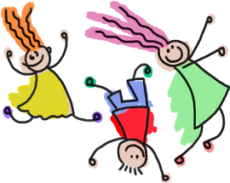
Like or Don’t like
Did everyone like the same things?
Were you wrong if you didn’t like carrots?
Notes:
Tell the children the number of LIKES and DON’T LIKES on the back of the cards, and ask:
• Did everyone like the same things?
• Were you wrong if you didn’t like carrots?

Slide 22
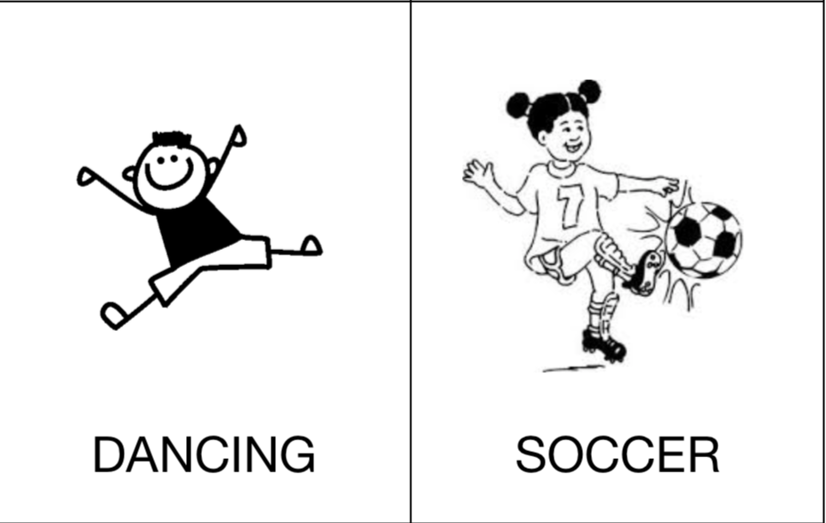
Like or Don’t like
Notes:
Continue with all the pictures, and record the number of LIKES and DON’T LIKES on the back of each picture. Add up the numbers.

Slide 23
Like or Don’t like
Notes:
Continue with all the pictures, and record the number of LIKES and DON’T LIKES on the back of each picture. Add up the numbers.

Slide 24
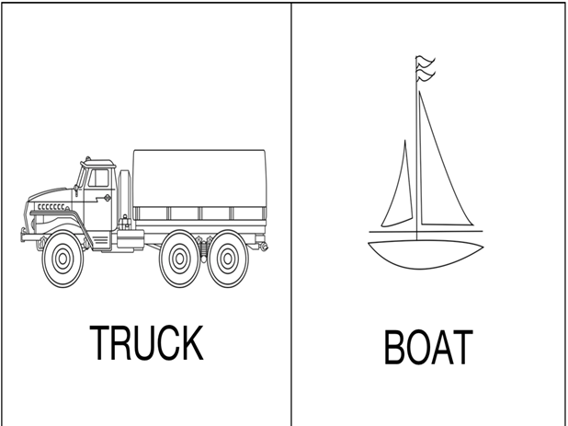
Like or Don’t like
Notes:
Continue with all the pictures, and record the number of LIKES and DON’T LIKES on the back of each picture. Add up the numbers.

Slide 25
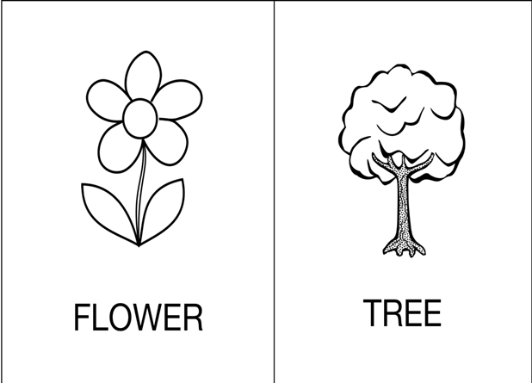
Like or Don’t like
Notes:
Continue with all the pictures, and record the number of LIKES and DON’T LIKES on the back of each picture. Add up the numbers.

Slide 26
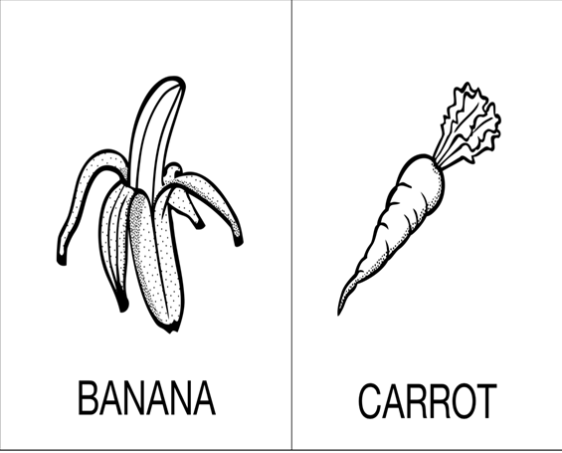
Like or Don’t like
Notes:
Continue with all the pictures, and record the number of LIKES and DON’T LIKES on the back of each picture. Add up the numbers.

Slide 27
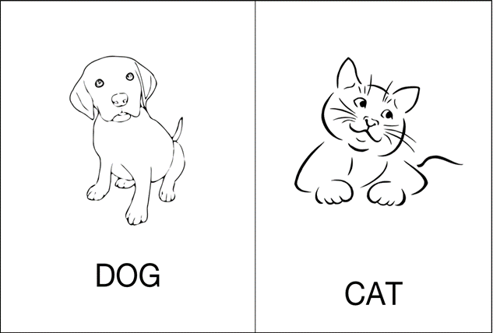
Like or Don’t like
Notes:
Continue with all the pictures, and record the number of LIKES and DON’T LIKES on the back of each picture. Add up the numbers.

Slide 28
Convention on the Rights of the Child Article 13
You have the right to find out things and share what you think with others, by talking, drawing, writing, or in any other way…
…unless it harms the rights of other people or hurts their reputation.
Notes:
Let’s read what the Convention on the Rights of the Child says about this. Who would like
to hold up the sign while we read it together?
You have the right to find out things and share what you think with others, by talking,
drawing, writing, or in any other way – unless it harms the rights of other people or
hurts their reputation.
Explain: We all have the right to say what we think as long as we respect other people, or in
other words, as long as we don’t hurt their feelings by saying mean things.
Place the mini poster with the others where the children can see it.

Slide 29
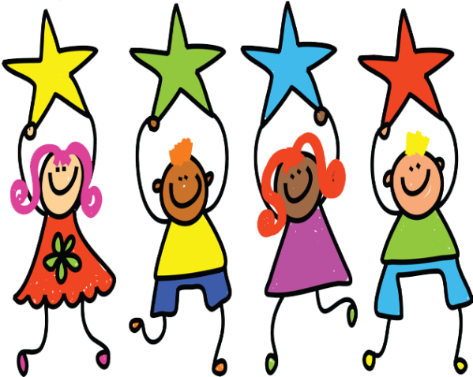
How did Peter’s brothers help him feel better?
What words did they say to him?
Who can tell me what they did to make him feel better?
Notes:
ASK: How did Peter’s brothers help him feel better?
DISCUSS: Accept student answers.
ASK: What words did they say to Peter?
DISCUSS: Accept student answers.
ASK: Who can tell me what they did to make Peter feel better?
DISCUSS: Accept student answers.

Slide 30
Words can be used to make people feel good and to make them feel bad.
We need to be thoughtful and kind about the way we say things and the words we use.
Notes:
SAY: Words can be used to make people feel good and to make them feel bad. We need to be thoughtful and kind about the way we say things and the words we use.

Slide 31
Conclusion
Words can be used to make people feel good or to make them feel bad.
We need to be thoughtful and kind about the way we say things and the words we use.
Notes:
1. Everyone has a right to say what they think. But there are limits to this right. 2. We are not free to say things that will hurt or endanger other people. 3. Words can be used to make people feel good and to make them feel bad. 4. We need to be thoughtful and kind about the way we say things and the words we use.

Slide 32
Learning Points
Everyone has a right to say what they think.
There are limits to this right.
We are not free to say things that will hurt other people.
Notes:
1. Everyone has a right to say what they think. But there are limits to this right. 2. We are not free to say things that will hurt or endanger other people. 3. Words can be used to make people feel good and to make them feel bad. 4. We need to be thoughtful and kind about the way we say things and the words we use.

Slide 33
Challenge
Tell others about the story of Peter and his brothers and how their words made him feel both happy and sad. This week, use your actions and words to help others feel happy.
Notes:
SAY: Tell your friends and family the story of Peter and his brothers and how the words they used made him feel both happy and sad. This week I want you to use your actions and words to help others feel happy.

Slide 35
References
1 | Visit the Geneva Office on Human Rights Education website to download and print lesson resources at www.go-hre.org
2 | United Nations Universal Declaration of Human Rights. https://www.un.org/en/universal-declaration-human-rights/
3 | United Nations Convention on the Rights of the Child. https://www.ohchr.org/en/professionalinterest/pages/crc.aspx

Slide 36
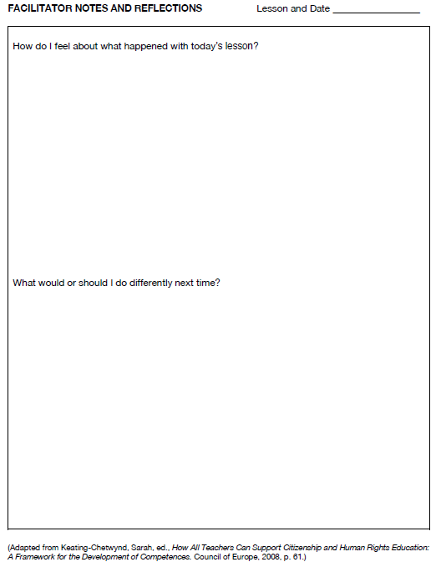
Resources

Slide 37
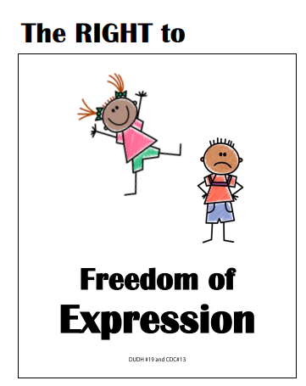
Resources

Slide 38
Convention on the Rights of the Child Article 13
You have the right to find out things and share what you think with others, by talking, drawing, writing, or in any other way…
…unless it harms the rights of other people or hurts their reputation.
Resources

Slide 39
Resources

Slide 40
We Are Different
1. I know you, and you know me. We are as different as the sun and the sea.
I know you, and you know me, And that’s the way it’s supposed to be.
2. I help you, and you help me. We learn from problems, and we’re starting to see.
I help you, and you help me, And that’s the way it’s supposed to be.
3. I love you, and you love me. We reach together for the best we can be.
I love you, and you love me, And that’s the way it’s supposed to be.
Resources

Slide 41
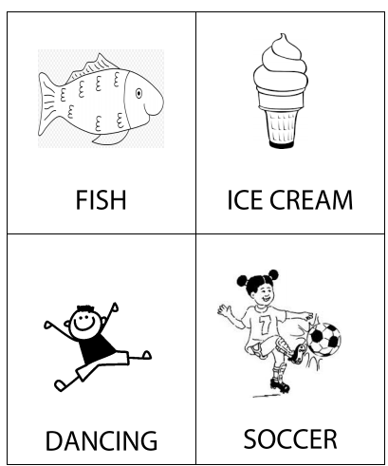
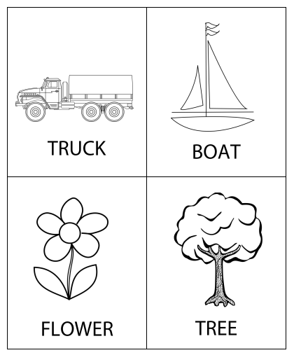
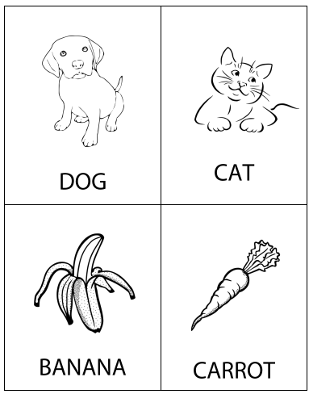
Like or Don’t Like Pictures
Resources

Slide 42
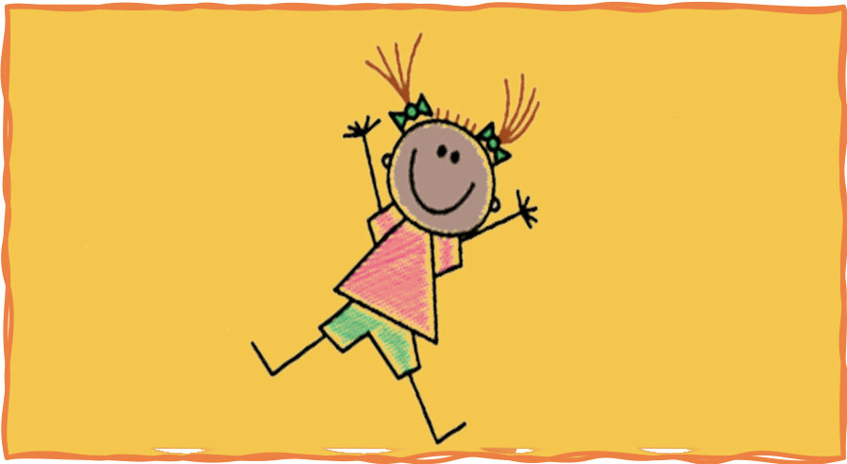
Colega
Words Make a Difference Lesson 7A
Geneva Office of Human Rights Education

