Slide 2
Facilitator Tips
1 | Prepare for Activity Sad Face, Mad Face, Glad Face | Read and prepare to for the activity. When you say the words in the activity “Sad Face, Mad Face, Glad Face” say it in a neutral way, with no emotion
2 | Talking Stick | Have students use the talking stick when students want to say something.
3 | Write Down Notes and Reflections | Don't forget to fill out the notes and reflections section

Slide 3
Materials Needed
1 | Talking Stick
2 | Class Roll
3 | Class Rules Chart
4 | Chalkboard or Flipchart and chalk or Markers
5 | Facilitator Notes and Reflections
6 | Mini-poster “The Right to Freedom of Expression”
7 | Document: Convention on the Rights of the Child Article 13
8 | Pencils
9 | 9 small strips of paper for each student

Slide 4
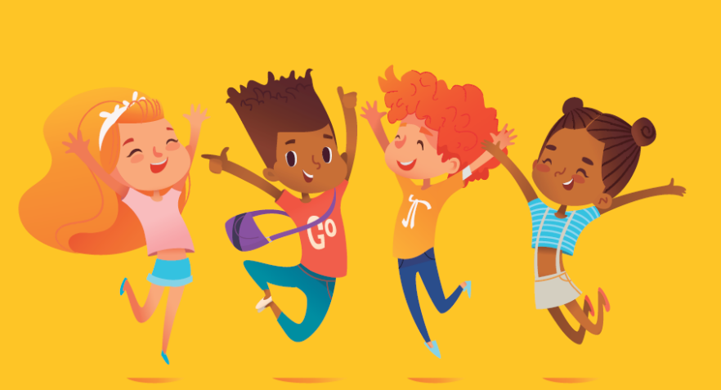
Words Make a Difference 1 Lesson 7B
Freedom of Expression

Slide 5
Welcome and Warm Up
Notes:
WELCOME and WARMUP(5 minutes)
Greet each child enthusiastically upon arrival, and show her or him where to sit. Briefly introduce yourself and tell the children how happy and excited you are to be starting this course about human rights. Explain that you love human rights and that they will, too.

Slide 6
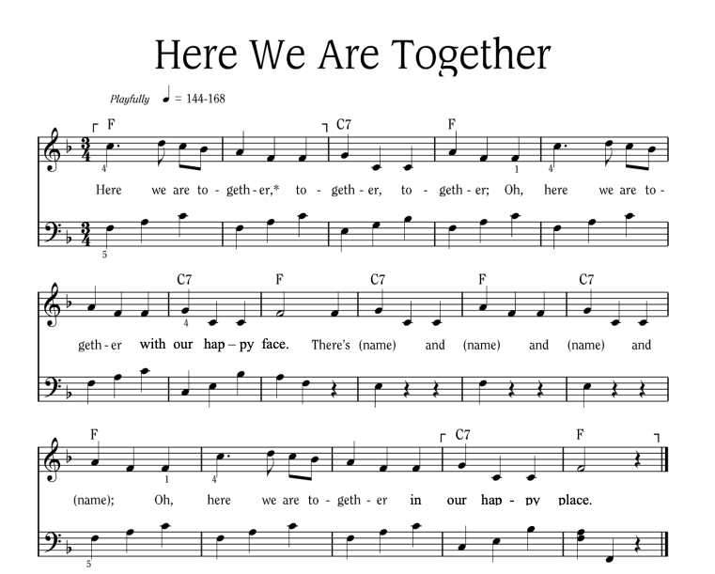
Notes:
Sing “Here We Are Together”
Sing the verse on your own, naming four different students. Point to the students and smile as you name them.
Repeat the song several times so that you can name many students.
To hear the melody:
To hear the melody: https://www.youtube.com/watch?v=XR9d7TsgQN8&list=PL1p11lCKMm7vUpyDMd39yUSVUUwUJ-Wa5&index=1
Sing with enthusiasm and delight.
Everyone: Here we are together, together, together. Here we are together with our happy face.
Facilitator: There’s Martha and Peter and Suzie and Henry (pointing to each of these children, one by one)
Everyone: Oh, here we are together in our happy place.
Sing the verse at least two or three times in a row so that you can name a few different children during each class.
Alternate Words:
Here we go a-walking
Here we are a-singing
Here we go a-marching
Here we are a-clapping
Make up actions based on the words! And you can make up your own words. Think of other phrases that might fit the music.

Slide 7
Here We Are Together
All
Here we are together, together, together,
Here we are together, with our happy face.
Teacher
There’s _________ and _________ and _________ and _________!
All
Oh, here we are together in our happy place!
Notes:
Sing “Here We Are Together”
Sing the verse on your own, naming four different students. Point to the students and smile as you name them.
Repeat the song several times so that you can name many students.
Everyone: Here we are together, together, together. Here we are together with our happy face.
Facilitator: There’s Martha and Peter and Suzie and Henry (pointing to each of these children, one by one)
Everyone: Oh, here we are together in our happy place.
Alternate Words:
Here we go a-walking
Here we are a-singing
Here we go a-marching
Here we are a-clapping
Make up actions based on the words! And you can make up your own words. Think of other phrases that might fit the music.
Alternate phrases: Here we go a-walking, Here we are a-singing, Here we go a-marching, Here we are a-clapping…etc. Improvise actions as suggested by the words.
The list above is only a few of the possibilities.
Consider other phrases that might fit the music and the occasion.

Slide 8
Alternate Words
Here we go a-walking
Here we are a-singing
Here we go a-marching
Here we are a-clapping
Make up actions based on the words!
And you can make up your own words.
Think of other phrases that might fit the music.

Slide 9
Review
Think about our story about Peter and his brothers.
Did anyone make their friends or family feel good by saying kind things to them this week?
Who would like to tell us about what happened to you this week when you used kind words?
Notes:
REVIEW (5 minutes)
Say: I’m still thinking about our story last week of Peter and his brothers. I have a feeling that there are people here who made some of their friends or family feel good by saying kind things to them or about them.
• Who would like to tell us about what happened to you this week when you used kind words?

Slide 10
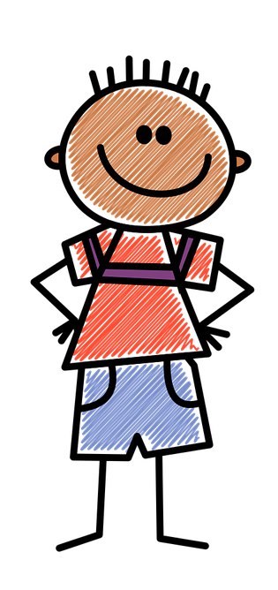
Convention on the Rights of the Child Article 13
You have the right to find out things and share what you think with others, by talking, drawing, writing, or in any other way…
…unless it harms the rights of other people or hurts their reputation.
Notes:
INTRODUCTION (5 minutes)
Ask: Do you remember that there are two big documents that we keep talking about that give you the right to think and to express yourself out loud, and to tell other people what you think?
Hold up the Article 13 sign. The first part of it should be visible, but the second part at the bottom of the page should be covered.
Read (or have one of the students read) the first part to the children:
You have the right to find out things and share what you think with others, by talking, drawing, writing or in any other way . . .

Slide 11
Should we always be able to say whatever we like?
Should we say things about other people that we know are not true?
How about if we call each other bad names?
What kind of language would hurt the rights of others? Stereotyping?
What kind of language would hurt the reputation of other people? Stereotypes?
Notes:
Ask: Should we always be able to say whatever we like?
• Should we say things about other people that we know are not true?
• How about if we call each other bad names?
• What kind of language would hurt the rights of others? Stereotyping?
• What kind of language would hurt the reputation of other people? Stereotypes?

Slide 12
There are times when we shouldn’t say what we are thinking.
This is what the last part of Article 13 says:
“... Unless it harms or offends other people or hurts their rights.”
Our words can be used to make people feel good or to make them feel hurt and sad.
Notes:
Guide the children to recognize that there are times when we shouldn’t say what we are thinking.
Explain: This is what the last part of Article 13 says about saying things that are damaging or hurtful to other people. Uncover the second part and read it or have one of the children read it: … unless it harms or offends other people or hurts their rights.
Explain: Our words can be used to make people feel good or make them feel hurt and sad.

Slide 13
Sad Face, Mad Face & Glad Face
Three faces
9 strips of paper
A pencil
Notes:
Activity: Sad Face, Mad Face and Glad Face (found at the end of the lesson)
Ask a child to hand out pencils, and another to hand out 9 strips of paper to each student.
Say: Please write your name or put an X on each piece of paper.
We are going to do an experiment.
I have 3 faces that I’m placing here on the floor (or the wall).
Hold up or point to each face, and ask the same question for each one.
Question: What does this face look like? (Let the children answer, and then point to the next one, and so on.)

Slide 14
What does this face look like?
Notes:
Ask the children what this face looks like. This is a Glad Face

Slide 15
What does this face look like?
Notes:
Ask the children what this face looks like. This is a Sad Face.

Slide 16
What does this face look like?
Notes:
Ask the children what this face looks like. This is a mad face.

Slide 17
How does this word make you feel?
Crazy
Notes:
Ask the children to put their piece of paper underneath the face that they associate with this word (e.g. Mad, or Glad)

Slide 18
How does this word make you feel?
Hot
Notes:
Ask the children to put their piece of paper underneath the face that they associate with this word (e.g. Mad, or Glad)

Slide 19
How does this word make you feel?
Soft
Notes:
Ask the children to put their piece of paper underneath the face that they associate with this word (e.g. Mad, or Glad)

Slide 20
How does this word make you feel?
Funny
Notes:
Ask the children to put their piece of paper underneath the face that they associate with this word (e.g. Mad, or Glad)

Slide 21
How does this word make you feel?
Curious
Notes:
Ask the children to put their piece of paper underneath the face that they associate with this word (e.g. Mad, or Glad)

Slide 22
How does this word make you feel?
Smart
Notes:
Ask the children to put their piece of paper underneath the face that they associate with this word (e.g. Mad, or Glad)

Slide 23
How does this word make you feel?
Cool
Notes:
Ask the children to put their piece of paper underneath the face that they associate with this word (e.g. Mad, or Glad)

Slide 24
What Words Mean
Why do some words mean different things to different people?
Does it matter how they are said?
Does it matter who says them?
Notes:
Ask: Why do some of these words mean different things to different people?
• Does it matter how a word is said?
• Does it matter who says the word?
• Why do people use words like these?
Give the children plenty of time to make up their own ideas and draw their own conclusions; otherwise the connection to human rights won’t be as strong.
Guide them to recognize that a word that one child may consider playful, is a word that another child might feel to be hurtful.

Slide 25
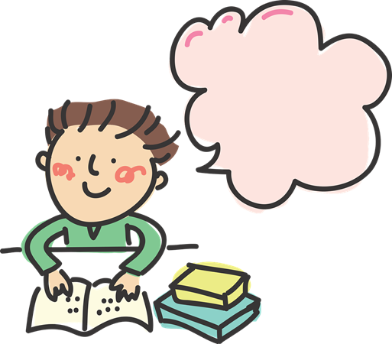
Jack, Matt, and Peter
Let’s read the end of their story again…
Notes:
SAY: Let’s read the end of the story again:

Slide 26
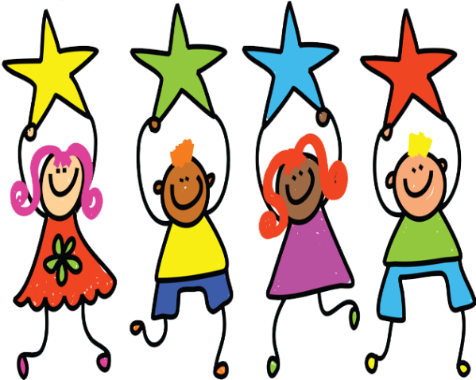
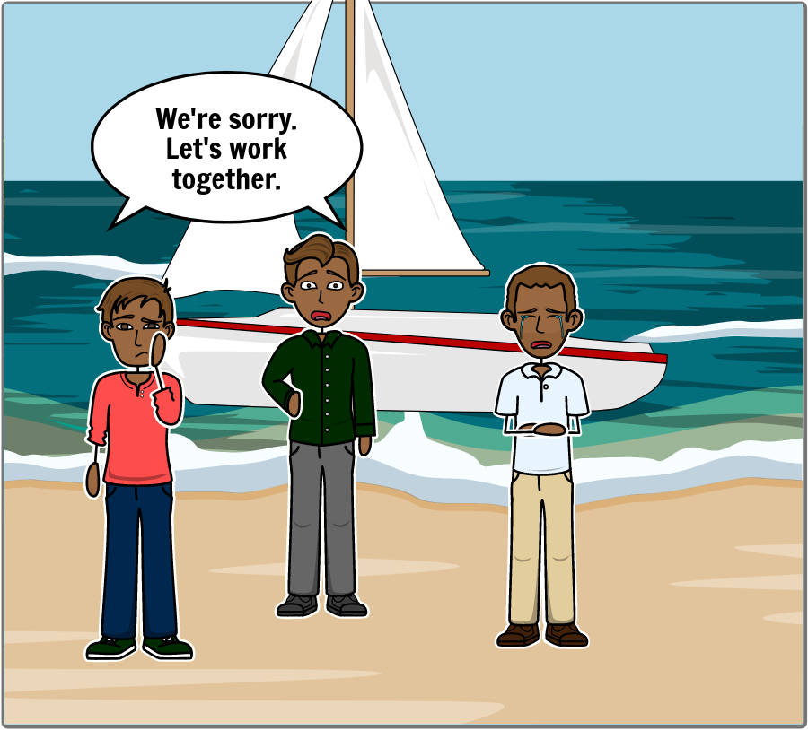
Jack and Matt told Peter that they were sorry.
Notes:
READ: “Jack and Matt told Peter that they were sorry.”
SAY: Look at your neighbor and tell her or him that you’re sorry.
ASK: What did your face look like?

Slide 27
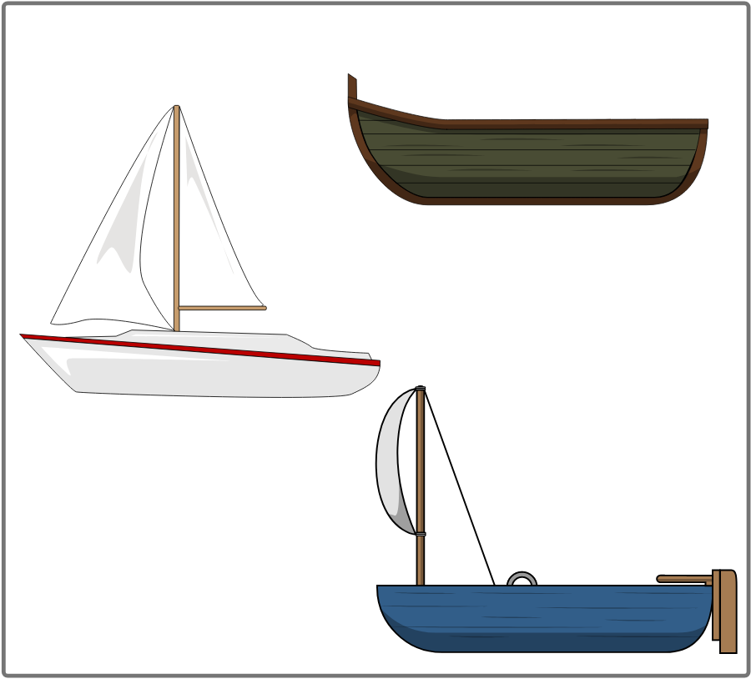
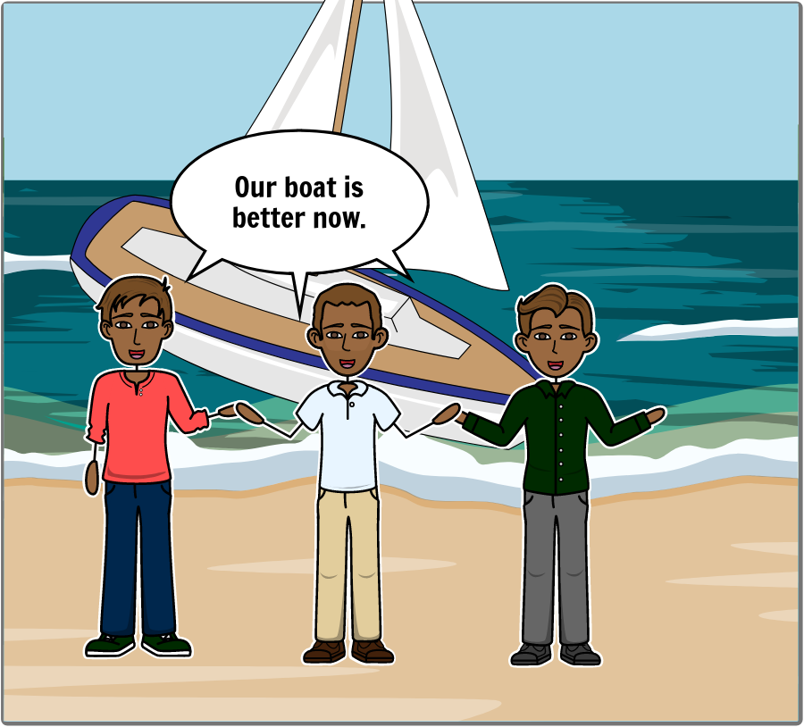
How do you feel when you think about how your words and actions affect others?
Notes:
READ: “They all looked at their pictures again. They decided they could use Peter’s picture for the front of the boat and Matt’s picture for the rest of the boat. Everyone was happy as they were building their new boat together.”
ASK: How do you feel when you think about how your words and actions affect others?
REVIEW: Give the children time to answer but don’t take too long.

Slide 28
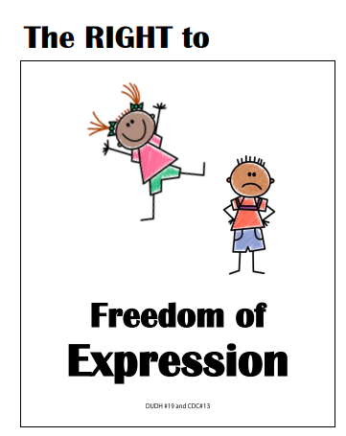
Your behavior and the way you speak to other people can make a big difference in their lives and in your own life.
Notes:
SAY: “These may be small things, but people are watching you more and more as you grow older. Your behavior and the way you speak to other people can make a big difference in their lives and in your own life.”
READ: “The right to freedom of express.”
Have the children read or repeat it with you.

Slide 29
Convention on the Rights of the Child Article 13 – Freedom of Expression
You have the right to find out things and share what you think with others, by talking, drawing, writing, or in any other way…
…unless it harms the rights of other people or hurts their reputation.
Notes:
SAY: “These may be small things, but people are watching you more and more as you grow older. Your behavior and the way you speak to other people can make a big difference in their lives and in your own life.”
READ: “You have the right to find out things and share what you think with others, by talking, drawing, writing or in any other way..unless it harms the rights of other people or hurts their reputation.”
NEXT: Have the children read or repeat it with you.

Slide 30
Review: Learning Points
Everyone has a right to say what they think. But there are limits to this right.
We are not free to say things that will hurt other people.
Notes:
SAY: Everyone has a right to say what they think. But there are limits to this right. We are not free to say things that will hurt or endanger other people.

Slide 31
Challenge
This week be extra thoughtful and try to use your words to make others feel happy.
Notes:
SAY: This week be extra thoughtful and try to use your words to help others feel happy. I can hardly wait to hear your stories next time about making people happy.

Slide 33
References
1 | Visit the Geneva Office on Human Rights Education website to download and print lesson resources at www.go-hre.org
2 | United Nations Universal Declaration of Human Rights. https://www.un.org/en/universal-declaration-human-rights/
3 | United Nations Convention on the Rights of the Child. https://www.ohchr.org/en/professionalinterest/pages/crc.aspx

Slide 34
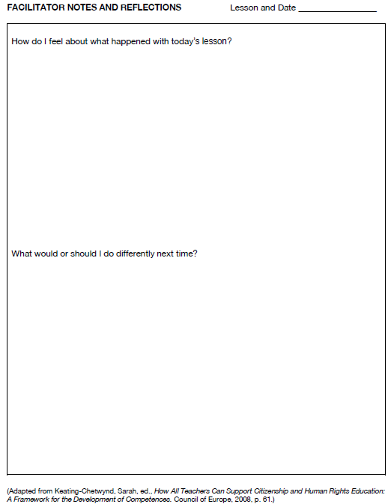
Resources

Slide 35
Resources

Slide 36
Convention on the Rights of the Child Article 13
You have the right to find out things and share what you think with others, by talking, drawing, writing, or in any other way…
…unless it harms the rights of other people or hurts their reputation.
Resources

Slide 37
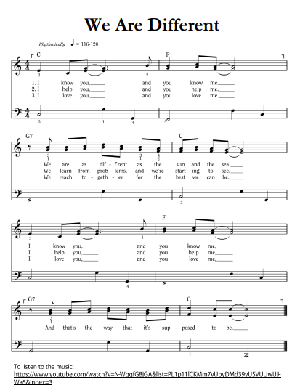
Resources

Slide 38
We Are Different
1. I know you, and you know me. We are as different as the sun and the sea.
I know you, and you know me, And that’s the way it’s supposed to be.
2. I help you, and you help me. We learn from problems, and we’re starting to see.
I help you, and you help me, And that’s the way it’s supposed to be.
3. I love you, and you love me. We reach together for the best we can be.
I love you, and you love me, And that’s the way it’s supposed to be.
Resources

Slide 39
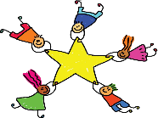
Review: Learning Points
Words can be used to make people feel good and to make them feel bad.
We need to be thoughtful and kind about the way we say things and the words we use.
Notes:
SAY: Words can be used to make people feel good and to make them feel bad. We need to be thoughtful and kind about the way we say things and the words we use.

Slide 40
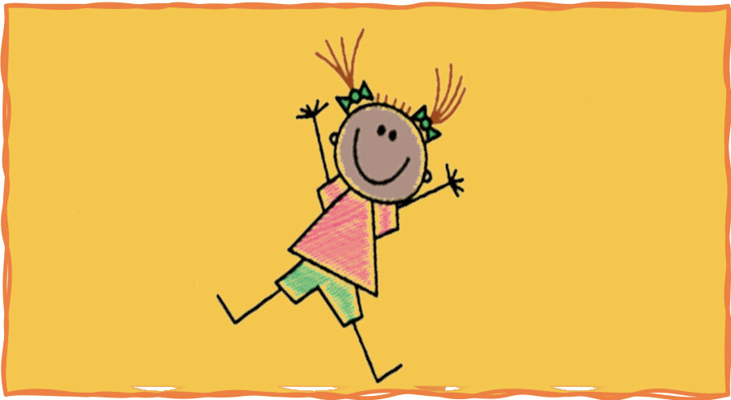
Colega
Words Make a Difference Lesson 7B
Geneva Office of Human Rights Education

