Slide 2
Facilitator Tips
1 | Use prompts to help students remember | A prompt can be a beginning of a phrase, "A person's a person"
2 | UDHR Article 6 | Prepare word strips for UDHR Article 6
3 | Talking Stick | Have students use the talking stick when students want to say something.
4 | Write Down Notes and Reflections | Don't forget to fill out the notes and reflections section

Slide 3
Materials Needed
1 | Talking Stick
2 | Class Roll
3 | Class Rules Chart
4 | Chalkboard or Flipchart and chalk or Markers
5 | Facilitator Notes and Reflections
6 | Mini-posters including The Right to Protection from Child Labor
7 | Photo, young boy in brickyard, follow the instructions in the lesson to prepare
8 | Word Strips for UDHR Article 6

Slide 4
Child Labor is Just Not Fair! 1 Lesson 9A
Protection from Child Labor

Slide 5
Welcome and Warm Up
Notes:
WELCOME and WARMUP(5 minutes)
Greet each child enthusiastically upon arrival, and show her or him where to sit. Briefly introduce yourself and tell the children how happy and excited you are to be starting this course about human rights. Explain that you love human rights and that they will, too.

Slide 6
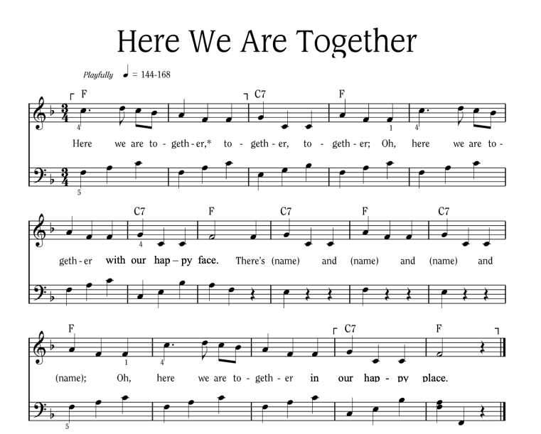
Notes:
Sing “Here We Are Together”
Sing the verse on your own, naming four different students. Point to the students and smile as you name them.
Repeat the song several times so that you can name many students.
To hear the melody:
To hear the melody: https://www.youtube.com/watch?v=XR9d7TsgQN8&list=PL1p11lCKMm7vUpyDMd39yUSVUUwUJ-Wa5&index=1
Sing with enthusiasm and delight.
Everyone: Here we are together, together, together. Here we are together with our happy face.
Facilitator: There’s Martha and Peter and Suzie and Henry (pointing to each of these children, one by one)
Everyone: Oh, here we are together in our happy place.
Sing the verse at least two or three times in a row so that you can name a few different children during each class.
Alternate Words:
Here we go a-walking
Here we are a-singing
Here we go a-marching
Here we are a-clapping
Make up actions based on the words! And you can make up your own words. Think of other phrases that might fit the music.

Slide 7
Here We Are Together
All
Here we are together, together, together,
Here we are together, with our happy face.
Teacher
There’s _________ and _________ and _________ and _________!
All
Oh, here we are together in our happy place!
Notes:
Sing “Here We Are Together”
Sing the verse on your own, naming four different students. Point to the students and smile as you name them.
Repeat the song several times so that you can name many students.
Everyone: Here we are together, together, together. Here we are together with our happy face.
Facilitator: There’s Martha and Peter and Suzie and Henry (pointing to each of these children, one by one)
Everyone: Oh, here we are together in our happy place.
Alternate Words:
Here we go a-walking
Here we are a-singing
Here we go a-marching
Here we are a-clapping
Make up actions based on the words! And you can make up your own words. Think of other phrases that might fit the music.
Alternate phrases: Here we go a-walking, Here we are a-singing, Here we go a-marching, Here we are a-clapping…etc. Improvise actions as suggested by the words.
The list above is only a few of the possibilities.
Consider other phrases that might fit the music and the occasion.

Slide 8
Alternate Words
Here we go a-walking
Here we are a-singing
Here we go a-marching
Here we are a-clapping
Make up actions based on the words!
And you can make up your own words.
Think of other phrases that might fit the music.

Slide 9
Review
Who had a chance to get someone in their family help them fill in the birth certificate?
What information did they give you?
What did your friends think of Horton, the elephant?
Do you remember what he said about small people?
Notes:
(Allow children time to answer.)
(Take all answers. Congratulate anyone who remembers that “A person’s a person, no matter how small.”)
Say: Very good! It’s great that you remember so much!
FACILITATOR TIP: If they can’t remember, give them a prompt such as the beginning of the phrase, “A person’s a person . . .” – slowly so they can join as they remember the rest.

Slide 10
Learning Points
You have a right NOT to work if it interferes with your school.
You have a right NOT to work if it is dangerous or bad for your health.
Notes:
LEARNING POINTS 1. You have a right NOT to work if the working hours interfere with your school and study times. 2. You have a right NOT to work if that work is dangerous or harmful to your health.

Slide 11
UDHR Article 6
Put these word strips in the correct order as a class!
Notes:
Possible Detailed Instructions:
Ask three children to work together to represent the word strips. Have these children put the word strips in order by standing in the order they think the words go.
Explain to the three: You have the words for Article 6 of the Universal Declaration of Human Rights. I want you to try to put these in the right order and then turn around and show everyone. When they turn around, stand behind them and say to the class: Hold up your thumb if you agree with me.
• Then hold your hand above the head of the child with the first word strip and say to the class: Do you agree that this one is right?
• If most of the children hold up their thumbs, move to the next child, and hold your hand above his or her head and say: Do you agree that this one is right?
• Do the same for the third child.
• If they are all in the right order, congratulate and thank them and let them sit down
• If they are not right, ask the class to help them put the words in the right order.
When the words are properly arranged, say: Let’s say it together one last time. You have a right / to be accepted everywhere / as a person before the law.
Thank the children and have them sit down.

Slide 12
Universal Declaration on Human Rights Article 6
Let’s say it together one last time:
“You have a right to be accepted everywhere as a person before the law.”
Notes:
Ask three children to come up and stand with their backs to the other children.
Give each child one of the word strips for UDHR Article 6, out of order. (You have a right / to be accepted everywhere / as a person before the law.)
Explain to the three: You have the words for Article 6 of the Universal Declaration of Human Rights. I want you to try to put these in the right order and then turn around and show everyone. When they turn around, stand behind them and say to the class: Hold up your thumb if you agree with me.
• Then hold your hand above the head of the child with the first word strip and say to the class: Do you agree that this one is right?
• If most of the children hold up their thumbs, move to the next child, and hold your hand above his or her head and say: Do you agree that this one is right?
• Do the same for the third child.
• If they are all in the right order, congratulate and thank them and let them sit down
• If they are not right, ask the class to help them put the words in the right order.
When the words are properly arranged, say: Let’s say it together one last time. You have a right / to be accepted everywhere / as a person before the law.
Thank the children and have them sit down.

Slide 13
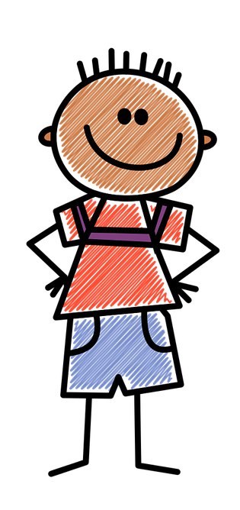
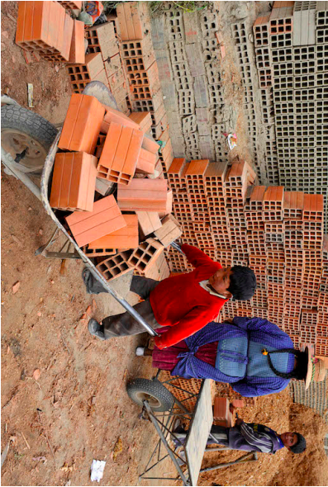
Introduction
We’re going to be detectives. What do you see?
Notes:
Say: We have many rights that allow us to do many different things. Today we’re going to talk about another one, but first we’re going to be detectives.
• We need to use our brains and our eyes and our ears. We need to use our mouths, too, but only when we’re holding the Talking Stick.
• I have a photograph I want to show you. Show the picture of the boy in the brickyard, covered with another sheet of paper that has a hole cut or torn out of it so that the children can see only the boy’s head.
Ask: What do you see? (A boy’s head.)

Slide 14
What do you see?
Notes:
Rip off the bottom right corner, about 3-4 inches up, to show the bricks.
Ask: What do you see now? (Bricks.)
• Does it change your opinion of what it’s about? (Allow the children to answer.)

Slide 15
What do you see?
Notes:
Rip off the top left corner, showing the women and some bricks.
Ask: What are your eyes telling you now – what do you think this photograph is telling us? (Accept all answers as the children pass the Talking Stick to each other.)

Slide 16
What do you see?
Notes:
Remove the rest of the paper.
Say: This photographer is trying to tell us a story about children who have to do dangerous and difficult work.

Slide 17
This photographer is trying to tell us a story about children who have to do dangerous and difficult work.

Slide 18
Develop & Discuss
What is a photographer?

Slide 19
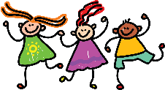
Develop & Discuss

Slide 22
What’s the Story?
Let’s use our detective skills to meet the photo and make sense of the story the photographer is trying to tell us

Slide 23
Who is in the picture and what is happening?

Slide 24
Question:
Why do you think it’s not fair?

Slide 25
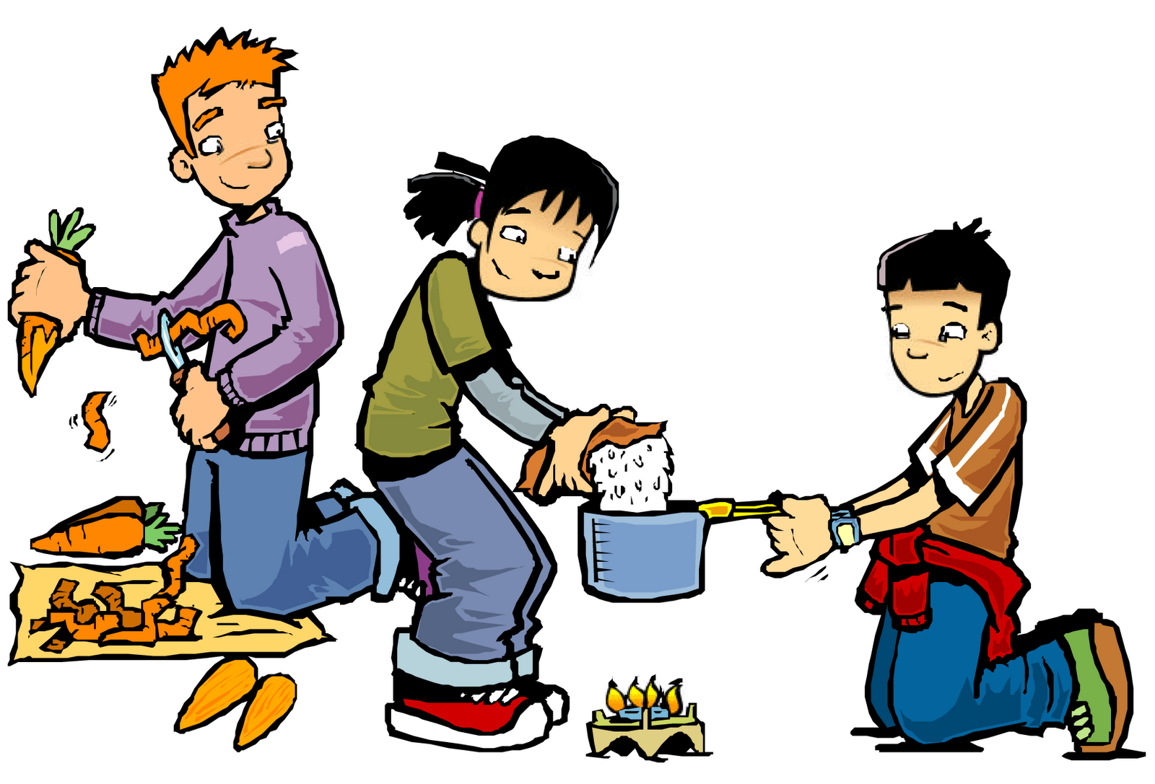
Conclusion
What chores do you do at home to help your family?
Notes:
SAY: Some work is good for children. It helps them learn how to care for themselves. It also helps their families when their children help with chores at home and in the fields.
ASK: What chores or work do you do at home to help your family? (Accept all answers.)
SAY: That’s good. It’s good to learn how to take care of yourselves and help others.

Slide 26
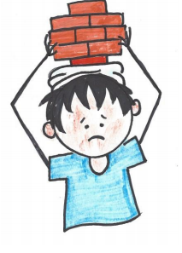
Conclusion
You have a right NOT to work if it is dangerous or bad for your health.
Child Labor
Notes:
SAY: That’s good. It’s good to learn how to take care of yourselves and help others. But sometimes hard work harms children, especially if they can’t go to school or rest or play. That is what we call “child labor”and it is not a good thing.
Let’s all say that together: CHILD LABOR.

Slide 27
Learning Points
You have a right NOT to work if it interferes with your school.
You have a right NOT to work if it is dangerous or bad for your health.
Notes:
LEARNING POINTS 1. You have a right NOT to work if the working hours interfere with your school and study times. 2. You have a right NOT to work if that work is dangerous or harmful to your health.

Slide 28
Challenge
Young boy working in a brickyard in Bolivia, South America. Photographed by Crozet M. 2010. © ILO
What have we learned about today? Share your detective skills about pictures.
Notes:
ASK: What have we learned about today? (Accept all answers.)
SAY: You’ve learned about using detective skills when you look at photographs to see what’s happening and what story the photographer is trying to tell and how it makes you feel. You can share these skills with your family and friends. It makes pictures more interesting.

Slide 29
Challenge
You have a right NOT to work if it interferes with your school.
Notes:
SAY: You’ve also learned about child labor today, and that it’s bad because it keeps you from going to school or having time to rest or play. Next time I’m going to tell you the story of Rupinder and what happened to him because of child labor. I can hardly wait to see you again. Have a wonderful week!

Slide 31
References
1 | Visit the Geneva Office on Human Rights Education website to download and print lesson resources at www.go-hre.org
2 | United Nations Universal Declaration of Human Rights. https://www.un.org/en/universal-declaration-human-rights/
3 | United Nations Convention on the Rights of the Child. https://www.ohchr.org/en/professionalinterest/pages/crc.aspx

Slide 32
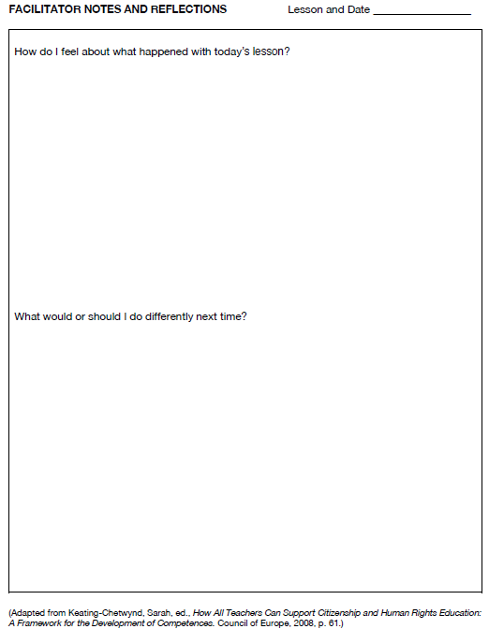
Resources

Slide 33
Resources

Slide 34
Resources

Slide 35
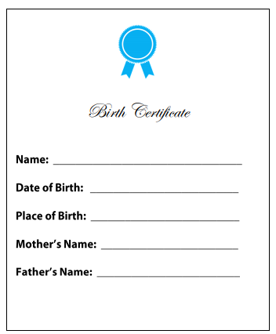
Resources

Slide 36
Universal Declaration on Human Rights Article 6
You have a right to be accepted everywhere as a person before the law
Resources

Slide 37
Convention on the Rights of the Child Article 32 – Protection from Child Labor
You should be protected from work that is dangerous to your health…
…or work that interferes with your education.
Resources

Slide 38
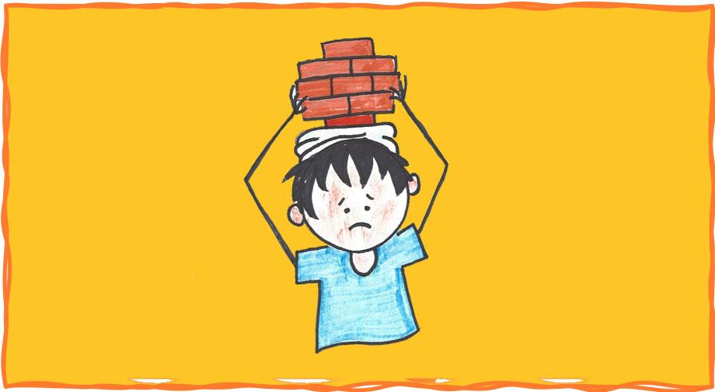
Child Labor is Just Not Fair! 1 Lesson 9A
Colega
Geneva Office of Human Rights Education

