Slide 1
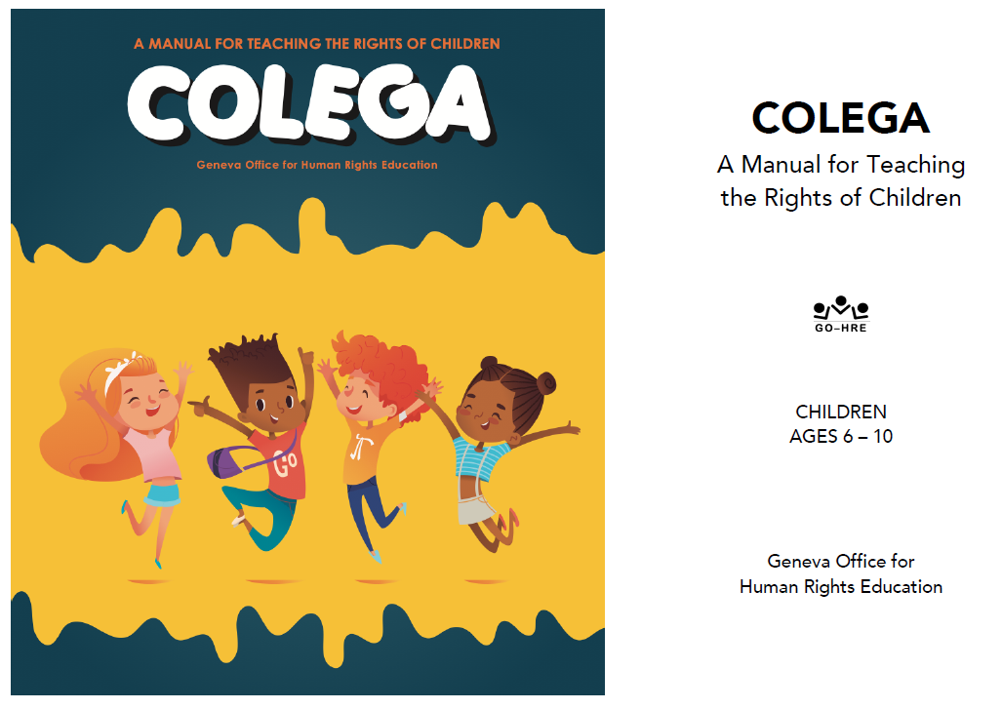

Slide 2
Facilitator Tips
1 | Read Malala’s Story | Read and prepare to tell Malala’s Story. Telling the story with inflection from memory will keep the children more engaged.
2 | Questions in a Box | Time will not allow for more than two questions per team. Save the extra questions to use at the end of the lesson or for another occasion.
3 | Talking Stick | Have students use the talking stick when students want to say something.
4 | Write Down Notes and Reflections | Don't forget to fill out the notes and reflections section

Slide 3
Materials Needed
1 | Talking Stick
2 | Class Roll
3 | Class Rules Chart
4 | Chalkboard or Flipchart and chalk or Markers
5 | Facilitator Notes and Reflections
6 | Mini-posters including The Right to Education
7 | Malala and her story
8 | 6 to 7 slips of paper
9 | Pencils
10 | Child Labor photos
11 | Documents: UNDR Article 26; CRC Articles 28 & 29
12 | Set of Job Images
13 | Basket or container for the papers

Slide 4
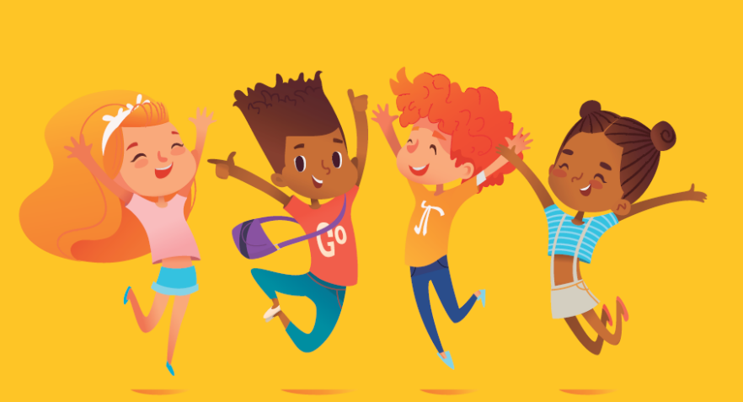
I Get to Go to School 1 Lesson 10A
The Right to Education

Slide 5
Welcome and Warm Up
Notes:
WELCOME and WARMUP(5 minutes)
Greet each child enthusiastically upon arrival, and show her or him where to sit. Briefly introduce yourself and tell the children how happy and excited you are to be starting this course about human rights. Explain that you love human rights and that they will, too.

Slide 6
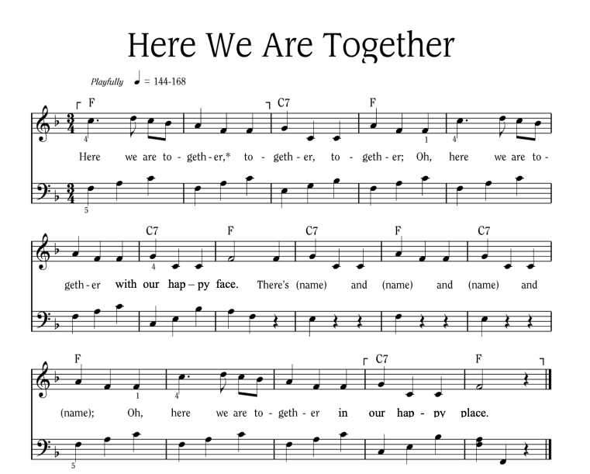
Notes:
Sing “Here We Are Together”
Sing the verse on your own, naming four different students. Point to the students and smile as you name them.
Repeat the song several times so that you can name many students.
To hear the melody:
To hear the melody: https://www.youtube.com/watch?v=XR9d7TsgQN8&list=PL1p11lCKMm7vUpyDMd39yUSVUUwUJ-Wa5&index=1
Sing with enthusiasm and delight.
Everyone: Here we are together, together, together. Here we are together with our happy face.
Facilitator: There’s Martha and Peter and Suzie and Henry (pointing to each of these children, one by one)
Everyone: Oh, here we are together in our happy place.
Sing the verse at least two or three times in a row so that you can name a few different children during each class.
Alternate Words:
Here we go a-walking
Here we are a-singing
Here we go a-marching
Here we are a-clapping
Make up actions based on the words! And you can make up your own words. Think of other phrases that might fit the music.

Slide 7
Here We Are Together
All
Here we are together, together, together,
Here we are together, with our happy face.
Teacher
There’s _________ and _________ and _________ and _________!
All
Oh, here we are together in our happy place!
Notes:
Sing “Here We Are Together”
Sing the verse on your own, naming four different students. Point to the students and smile as you name them.
Repeat the song several times so that you can name many students.
Everyone: Here we are together, together, together. Here we are together with our happy face.
Facilitator: There’s Martha and Peter and Suzie and Henry (pointing to each of these children, one by one)
Everyone: Oh, here we are together in our happy place.
Alternate Words:
Here we go a-walking
Here we are a-singing
Here we go a-marching
Here we are a-clapping
Make up actions based on the words! And you can make up your own words. Think of other phrases that might fit the music.
Alternate phrases: Here we go a-walking, Here we are a-singing, Here we go a-marching, Here we are a-clapping…etc. Improvise actions as suggested by the words.
The list above is only a few of the possibilities.
Consider other phrases that might fit the music and the occasion.

Slide 8
Alternate Words
Here we go a-walking
Here we are a-singing
Here we go a-marching
Here we are a-clapping
Make up actions based on the words!
And you can make up your own words.
Think of other phrases that might fit the music.

Slide 9
Questions in a Box
We’re going to play a game.
We will split into two teams.
Each team will choose a member to read a question.
Then the team will get to answer the question.
The team with the most points wins.
Notes:
Activity: Questions in a Box
Before the class begins: Cut out the questions from the REVIEW SHEET at the end of the lesson. Fold them in half and put them in a bowl or basket so that the questions cannot be easily seen.
Say: Let’s play a little game called “Questions in a Box.”
I’m going to count to three.
Before I get to three, girls go to the right, and boys go to the left.
1, 2, 3 – GO! How to play: Divide the class into 2 teams, such as girls against boys (or other variation).
Choose one child from each team. Flip a coin or draw straws to see which team goes first.
First person takes a question from the basket and gives it to the facilitator to read out loud.
She must then turn to the team and ask for a collective answer, which she announces to the facilitator.
If the answer is correct, her team gets a point.
If no one on the team knows the answer, the other team has a chance to answer.
If they get it right, they get a point.
If no one gets it right, the facilitator answers the question, no one gets a point, and the game continues.
It’s now the other team’s turn to have a player choose a question.
No matter who gets a point, the teams alternate answering questions.
The team with the most points wins.
Switch back and forth between the teams quickly so the review doesn’t take too long.
Facilitator Tip: Time will not allow for more than 2 questions per team. Save the extra questions to use at the end of the lesson or for another occasion.

Slide 10
What is the name of the special document that has all our rights?
How many rights does a person with disabilities have?
What do we call the rights that we all have?
Name any two rights that we have.
What’s the word for ignoring people who are different than we are?
What is the name of the wonderful document that’s just for children?
Notes:
Answers to the questions:
1. What is the name of the special document that has all our rights? THE UNIVERSAL DECLARATION OF HUMAN RIGHTS
2. How many rights does a person with disabilities have? ALL OF THEM
3. What do we call the rights that we all have? HUMAN RIGHTS
4. Name two rights that we have. THE RIGHT TO BE FREE AND SAFE. THE RIGHT TO A FAMILY. Or any others that were mentioned in previous classes.
5. What’s the word for ignoring people who are different than we are? DISCRIMINATION
6. What is the name of the wonderful document that’s just for children? THE CONVENTION ON THE RIGHTS OF THE CHILD

Slide 11
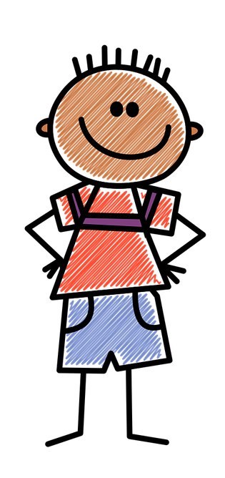
Introduction
Today we’re going to learn about your RIGHT to go to school and get an education. I’m going to tell you the true story about a girl named Malala.
Notes:
INTRODUCTION (10 minutes) Say: Thank you all for playing so well. It’s wonderful to see how much you remember!
• Today we’re going to learn about your RIGHT to go to school and get an education. I’m going to tell you the true story about a girl named Malala.
Have the children sit in a semi-circle around you in front of the chalkboard or easel.
Activity: The Story of Malala
Say: Malala is from Pakistan, a country near India. She was only 15 years old when some people tried to hurt her just because she said girls should have the right to go to school. Show the picture of a Muslim girl and tell Malala’s story (at the end of the lesson).
FACILITATOR TIP: If you have time, read the story beforehand so that you can tell it to the children without reading it. It will be more interesting for them.

Slide 12
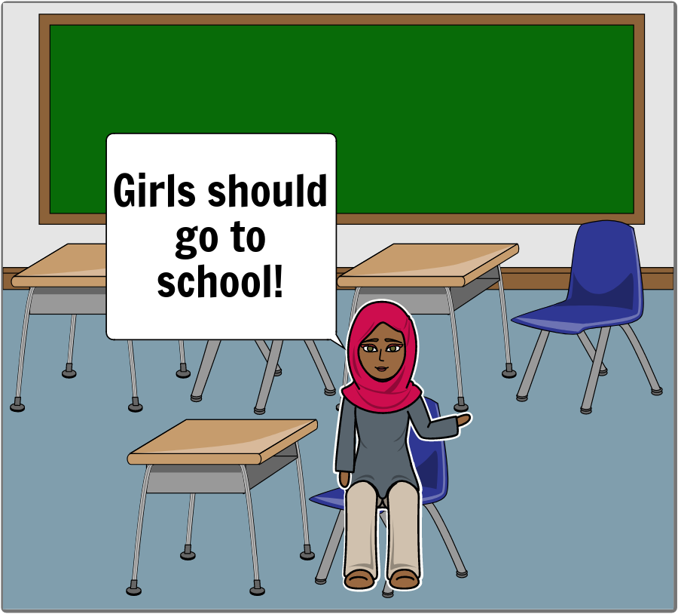
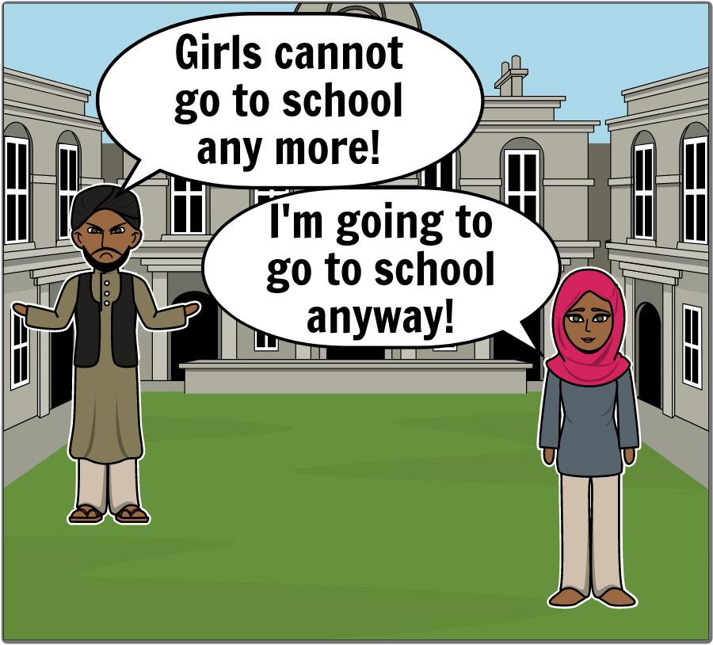
The Story of Malala
Notes:
Pakistan is a beautiful country but more than half the girls there don’t go to school even though most of the boys did. But Malala was very lucky because her father was in charge of a big school and he thought girls should go to school. So Malala went to school every day and was very happy. Then there was a war in her country, and the soldiers from the enemy side were called the Taliban. When they came to her town, they said girls couldn’t go to school, but Malala and her friends refused to obey them. They loved school and they kept going. So the Taliban issued a death threat against her but nobody thought they would actually kill a young girl.

Slide 13
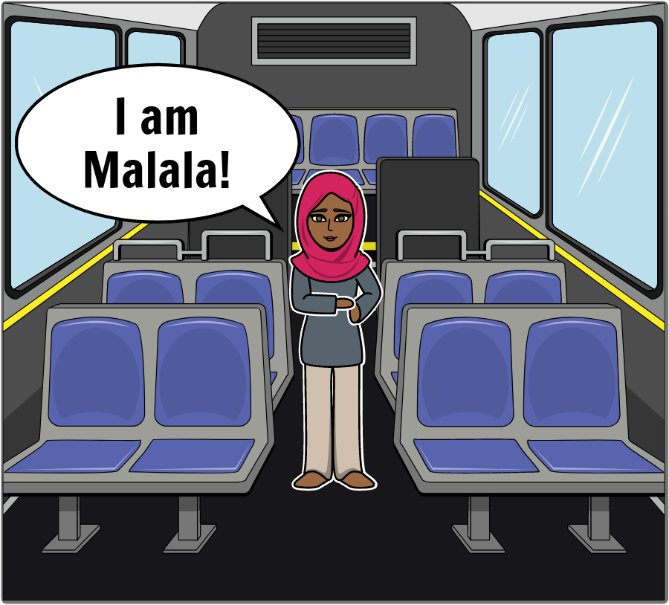
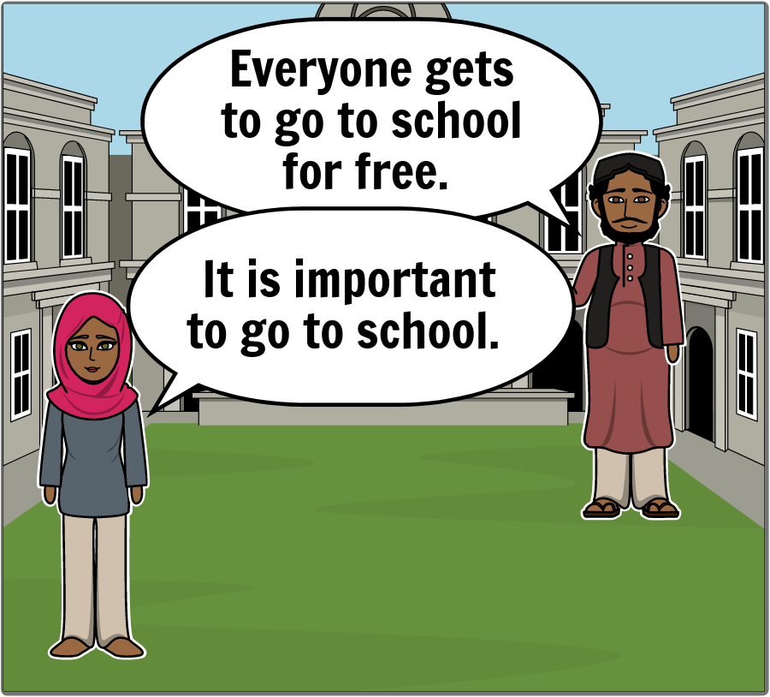
Notes:
One day when Malala was 15 years old, she was riding a bus with friends on their way home from school, when a masked gunman stopped the bus and got on board, and shouted, “Who is Malala?” Then he fired at her, hitting Malala in the head before he ran away. Malala almost died. People around the world were shocked and angry. The government of Pakistan made a new law called the Right to Free and Compulsory Education. Compulsory means that it’s something you have to do. So the new law meant that school was free and that you had to go. That was really amazing. Malala survived from the attack, and today she speaks all over the world in favor of education, especially for girls. She is also a student at one of the best universities in the world, Oxford University in Great Britain.

Slide 14
How do you know that education was important to Malala?
How do you know that she was brave?
Notes:
After the story, ask:
How do you know that education was important to Malala? (She talked to people about education for everyone, especially girls.)
• How do you know that she was brave? (She went to school even though the enemy army threatened to kill her.)

Slide 15
Develop & Discuss
The Right to an Education

Slide 16
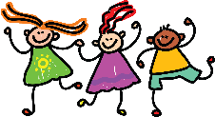

Slide 19
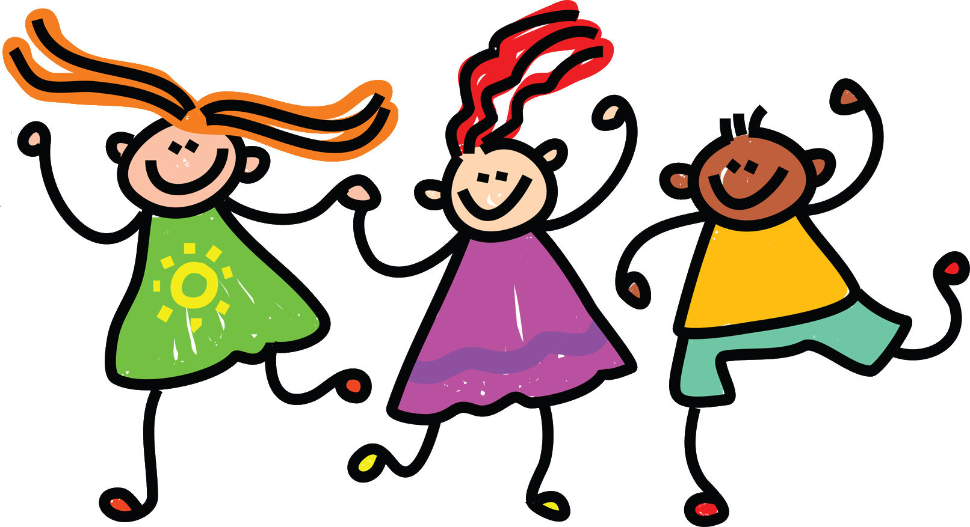

Slide 20
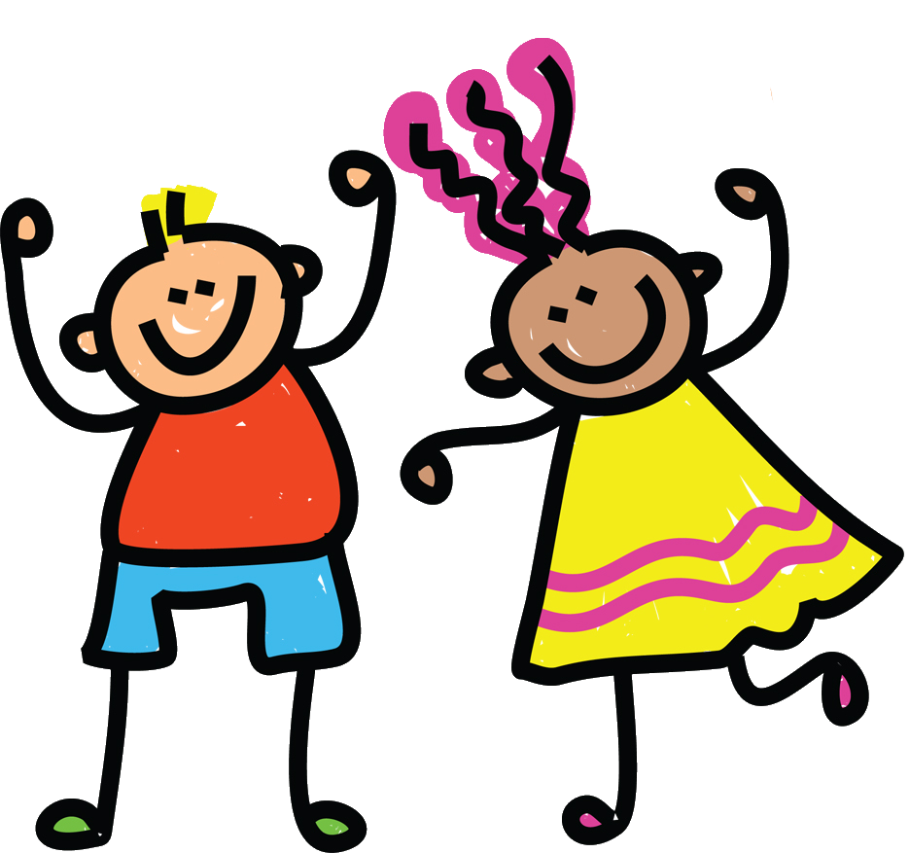
Convention on the Rights of the Child Article 28
Children have a right to an education.
Discipline in schools should be done fairly, with kindness and respect.
Primary education should be free and required.

Slide 21
Without an Education…
Do you think you would know:
how to read and write?
about Human Rights?
about the Universal Declaration
of Human Rights?

Slide 22
Your Future
Who do you think is going to take care of you after you grow up and leave home?
What will you need to take care of yourself after you leave home?

Slide 23
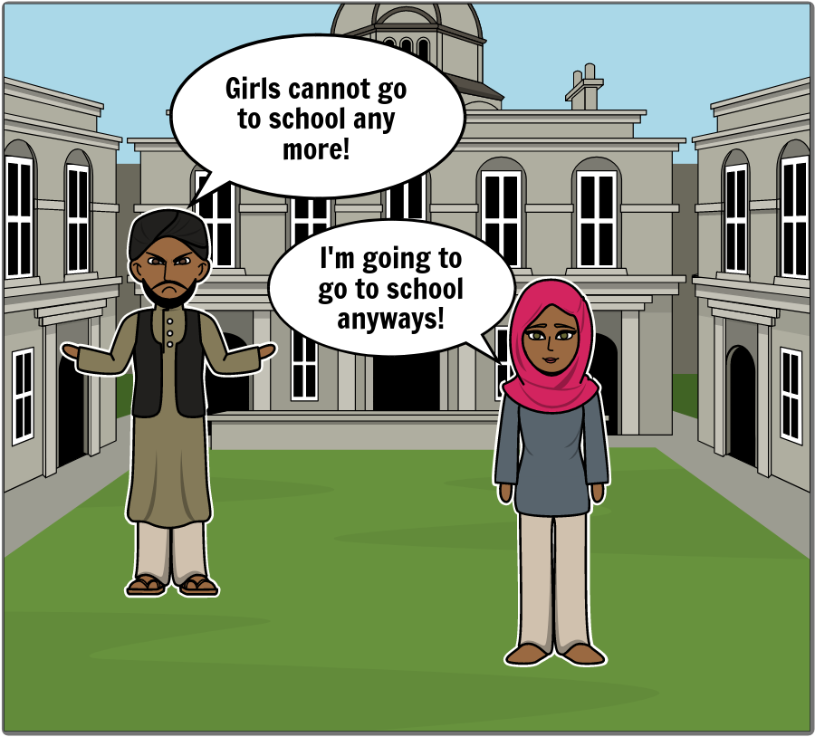
Conclusion
Remember Malala’s story.
Notes:
ASK: Who remembers why someone tried to hurt Malala? (They didn’t think girls should have the right to go to school and Malala told everything that girls SHOULD go to school.)

Slide 24
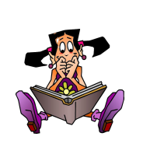
We are really lucky to HAVE the right to an EDUCATION so we can all go to school!
Notes:
SAY: We are really lucky to HAVE the Right to an Education so we call all go to school!

Slide 25
Learning Points
Education prepares you to learn the skills you will need in the future.
All children have the right to an education.
Children can become teachers.
Notes:
1. Education prepares you to learn skills you will need in the future. 2. All children have the right to an education. 3. Children can become teachers.

Slide 26
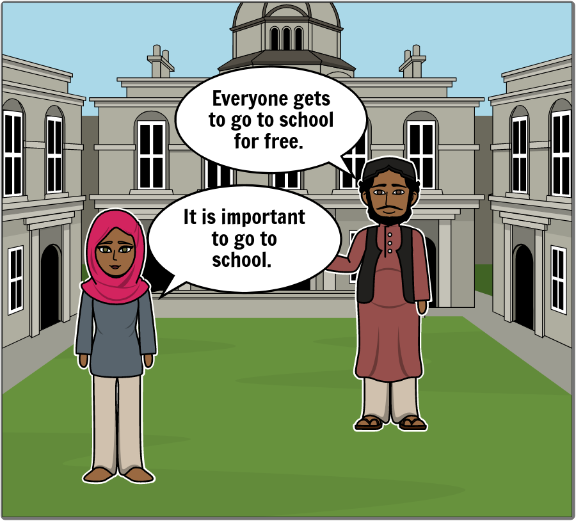
Challenge
Share Malala’s story with someone about our right to have an education.
Notes:
Share the story of Malala with your friends and family and we’ll talk about it next time. Have a wonderful week and tell your family about everybody’s right to have an education.

Slide 28
References
1 | Visit the Geneva Office on Human Rights Education website to download and print lesson resources at www.go-hre.org
2 | United Nations Universal Declaration of Human Rights. https://www.un.org/en/universal-declaration-human-rights/
3 | United Nations Convention on the Rights of the Child. https://www.ohchr.org/en/professionalinterest/pages/crc.aspx

Slide 29
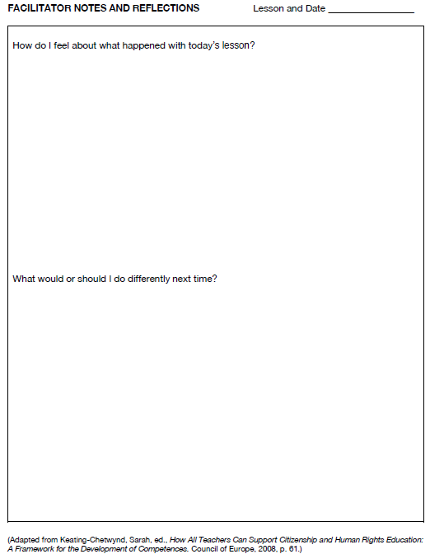
Resources

Slide 30
Resources

Slide 31
Universal Declaration on Human Rights Article 26
You have the right to go to school. You should be able to learn a profession or continue your studies as far as you can.
Your parents have a right to choose how and what you learn.
You should learn about the United Nations and how to get along with other people and respect their rights.
Resources

Slide 32
Convention on the Rights of the Child Article 28
Children have a right to an education.
Discipline in schools should be done fairly, with kindness and respect.
Primary education should be free and required.
Resources

Slide 33
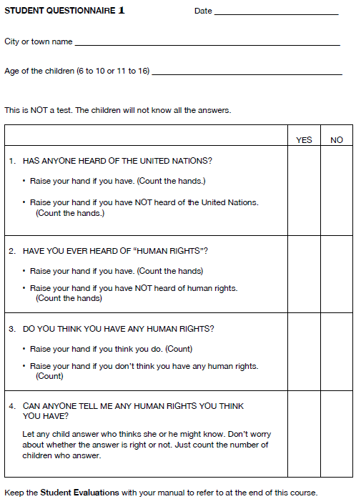
Resources

Slide 34
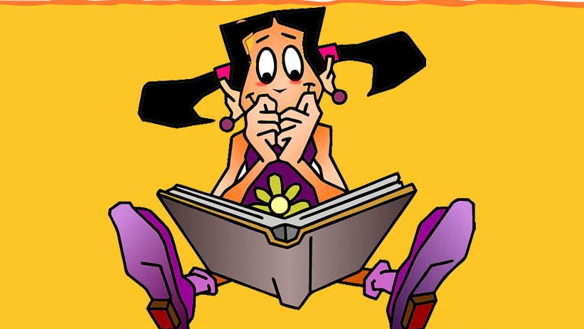
I Get to Go to School 1 Lesson 10A
Colega
Geneva Office of Human Rights Education

