Slide 2
Facilitator Tips
1 | Get Help for Questionnaire | Ask someone else to assist you with the questionnaire. Ask them to count and record the answers with you
2 | Prepare Working Pictionary Activity | Study the direction on how to play the game and prepare before the class.
3 | Talking Stick | Have students use the talking stick when students want to say something.
4 | Write Down Notes and Reflections | Don't forget to fill out the notes and reflections section

Slide 3
Materials Needed
1 | Talking Stick
2 | Class Roll
3 | Class Rules Chart
4 | Chalkboard or Flipchart and chalk or Markers
5 | Facilitator Notes and Reflections
6 | Mini-posters including The Right to Education
7 | Picture of Malala with Quotes
8 | 6 to 7 slips of paper
9 | Pencils
10 | Child Labor photos
11 | Documents: UNDR Article 26; CRC Articles 28 & 29
12 | Set of Job Images
13 | Basket or container for the papers

Slide 4
I Get to Go to School 1 Lesson 10B
The Right to Education

Slide 5
Welcome and Warm Up
Notes:
WELCOME and WARMUP(5 minutes)
Greet each child enthusiastically upon arrival, and show her or him where to sit. Briefly introduce yourself and tell the children how happy and excited you are to be starting this course about human rights. Explain that you love human rights and that they will, too.

Slide 6
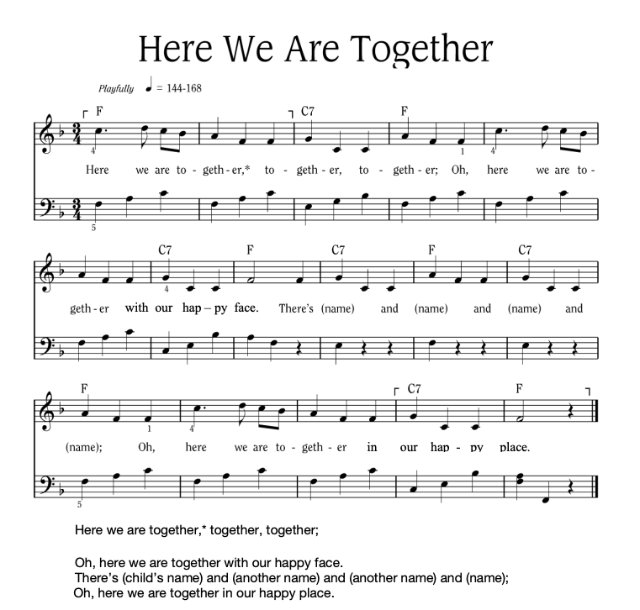
Notes:
Sing “Here We Are Together”
Sing the verse on your own, naming four different students. Point to the students and smile as you name them.
Repeat the song several times so that you can name many students.
To hear the melody:
To hear the melody: https://www.youtube.com/watch?v=XR9d7TsgQN8&list=PL1p11lCKMm7vUpyDMd39yUSVUUwUJ-Wa5&index=1
Sing with enthusiasm and delight.
Everyone: Here we are together, together, together. Here we are together with our happy face.
Facilitator: There’s Martha and Peter and Suzie and Henry (pointing to each of these children, one by one)
Everyone: Oh, here we are together in our happy place.
Sing the verse at least two or three times in a row so that you can name a few different children during each class.
Alternate Words:
Here we go a-walking
Here we are a-singing
Here we go a-marching
Here we are a-clapping
Make up actions based on the words! And you can make up your own words. Think of other phrases that might fit the music.

Slide 7
Here We Are Together
All
Here we are together, together, together,
Here we are together, with our happy face.
Teacher
There’s _________ and _________ and _________ and _________!
All
Oh, here we are together in our happy place!
Notes:
Sing “Here We Are Together”
Sing the verse on your own, naming four different students. Point to the students and smile as you name them.
Repeat the song several times so that you can name many students.
Everyone: Here we are together, together, together. Here we are together with our happy face.
Facilitator: There’s Martha and Peter and Suzie and Henry (pointing to each of these children, one by one)
Everyone: Oh, here we are together in our happy place.
Alternate Words:
Here we go a-walking
Here we are a-singing
Here we go a-marching
Here we are a-clapping
Make up actions based on the words! And you can make up your own words. Think of other phrases that might fit the music.
Alternate phrases: Here we go a-walking, Here we are a-singing, Here we go a-marching, Here we are a-clapping…etc. Improvise actions as suggested by the words.
The list above is only a few of the possibilities.
Consider other phrases that might fit the music and the occasion.

Slide 8
Alternate Words
Here we go a-walking
Here we are a-singing
Here we go a-marching
Here we are a-clapping
Make up actions based on the words!
And you can make up your own words.
Think of other phrases that might fit the music.

Slide 9
Review: Questionnaire
I have a few questions before our lesson is presented today. Don’t worry if you don’t know the answers.
Notes:
STUDENT EVALUATION
The short questionnaire at the back of this lesson has the same questions that were used at the beginning of the manual in Lesson 1. It is fast and easy to do. When today’s lesson is over, compare the first questionnaire that was given with today’s questionnaire in order to evaluate how much the children have learned since the beginning of this course. Give this information to your supervisor.
Explain: I have a few questions before we talk about our lesson today. Don’t worry if you don’t know the answers.
How to do it: After each question, count the number for each answer and record it on the questionnaire. Keep this paper in a safe place to compare with the earlier questionnaire.
• It is very helpful to have another person do this with you, to count and record the answers.
Conduct the questionnaire, and say: Thank you for answering the questions so cheerfully. We’ve learned a lot about human rights from our lessons.

Slide 10
Has anyone heard of the United Nations?
Raise your hand if you have.
Raise your hand if you have not.
Notes:
This is important. It is our major source of data on this project. These must be clear and recorded
1. HAS ANYONE HEARD OF THE UNITED NATIONS?
• Raise your hand if you have. (Count the hands.)
• Raise your hand if you have NOT heard of the United Nations. (Count the hands.)

Slide 11
Have you ever heard of “Human Rights”?
Raise your hand if you have.
Raise your hand if you have not.
Notes:
This is important. It is our major source of data on this project. These must be clear and recorded
2. HAVE YOU EVER HEARD OF “HUMAN RIGHTS”?
• Raise your hand if you have. (Count the hands)
• Raise your hand if you have NOT heard of human rights. (Count the hands)

Slide 12
Do you think you have any human rights?
Raise your hand if you think you do.
Raise your hand if you don’t think have any human rights.
Notes:
This is important. It is our major source of data on this project. These must be clear and recorded
3. DO YOU THINK YOU HAVE ANY HUMAN RIGHTS?
• Raise your hand if you think you do. (Count)
• Raise your hand if you don’t think you have any human rights. (Count)

Slide 13
Can anyone tell me any human rights you think you have?
Raise your hand if you can think of an answer.
Notes:
This is important. It is our major source of data on this project. These must be clear and recorded
4. CAN ANYONE TELL ME ANY HUMAN RIGHTS YOU THINK YOU HAVE?
Let any child answer who thinks she or he might know. Don’t worry about whether the answer is right or not. Just count the number of children who answer.

Slide 14
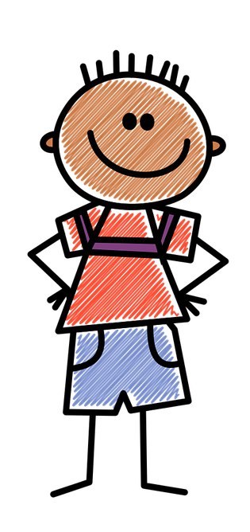
Notes:
INTRODUCTION (5 minutes)
Say: Let’s read Article 26 together from the Universal Declaration of Human Rights. It is a lot like the article from the Convention on the Rights of the Child that we read last week because education is so important.

Slide 15
Universal Declaration on Human Rights Article 26
You have the right to go to school. You should be able to learn a profession or continue your studies as far as you can.
Your parents have a right to choose how and what you learn.
You should learn about the United Nations and how to get along with other people and respect their rights.
Notes:
Show the mini poster, The Right to an Education.
Read (or ask a student to read): Article 26 of the Universal Declaration of Human Rights.
1. You have the right to go to school. You should be able to learn a profession or continue your studies as far as you can.
2. Your parents have the right to choose how and what you learn.
3. You should learn about the United Nations and how to get along with other people and to respect their rights.
Ask: Who can tell me what the word “profession” means? (It means “a job.”)

Slide 16
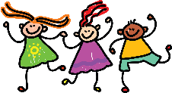

Slide 17
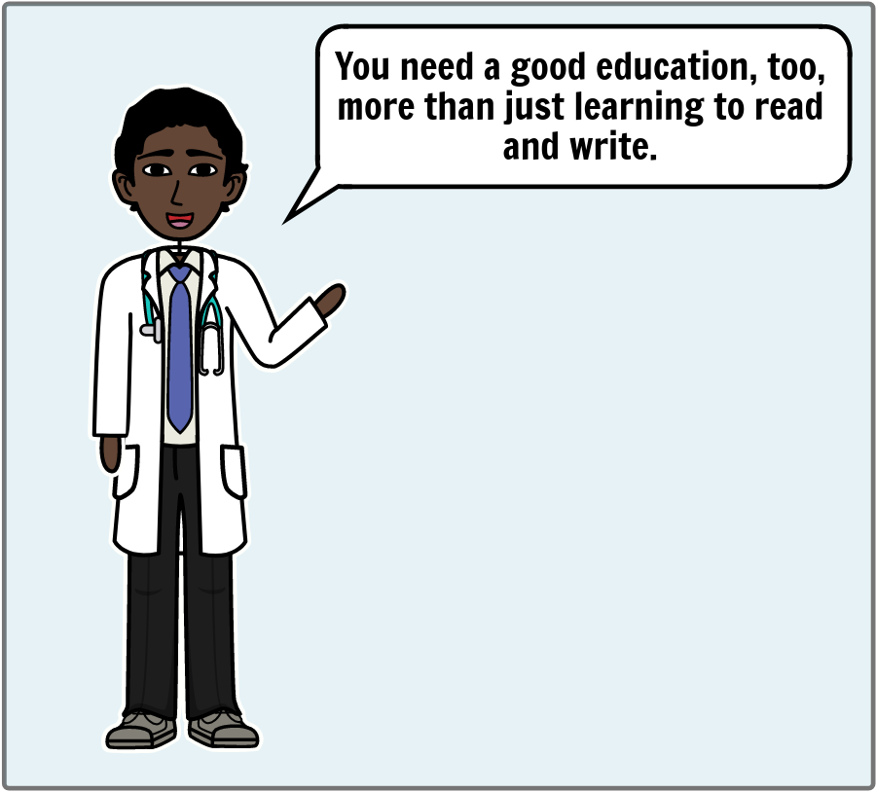

Slide 20
Different Types of Jobs
Let’s discuss different types of jobs.
Notes:
I have a few pictures of some professions or jobs to show you today.

Slide 21
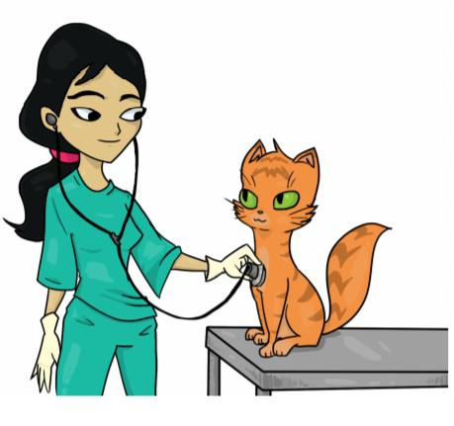
Veterinarian
Notes:
This is a veterinarian

Slide 22
Farmer or Agricultural Worker
Notes:
This is a famer or agricultural worker

Slide 23
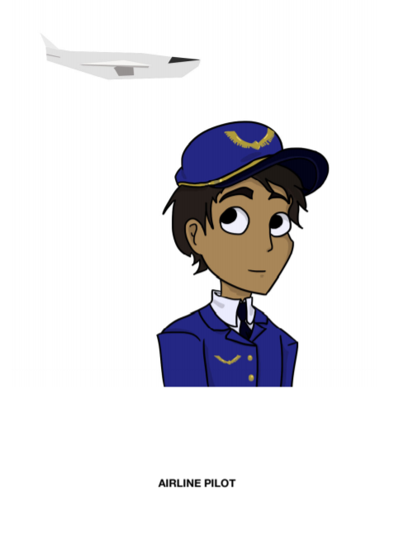
Airline Pilot
Notes:
This is an airlines pilot

Slide 24
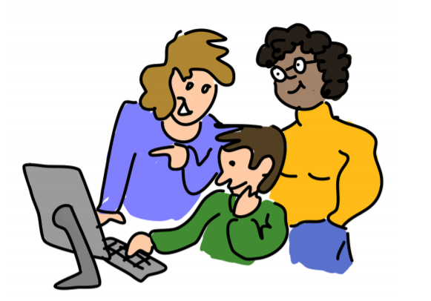
Teachers
Notes:
These are teachers

Slide 25
Construction Worker
Notes:
This is a construction worker

Slide 26
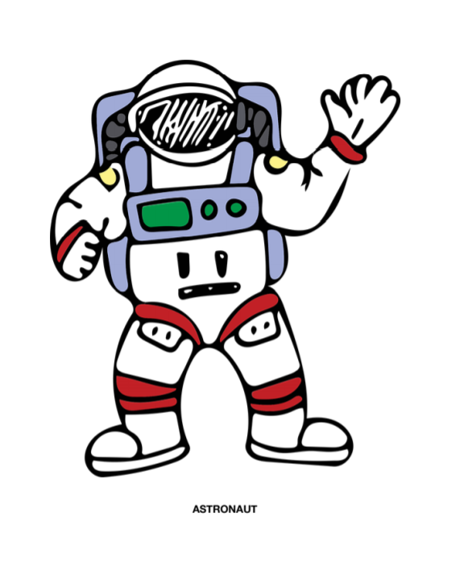
Astronaut
Notes:
This is an astronaut

Slide 27
Taxi Driver
Notes:
This is a taxi driver

Slide 28
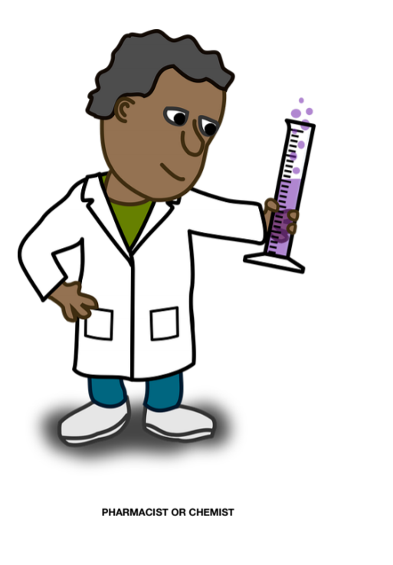
Pharmacist or Chemist
Notes:
This is a pharmacist or chemist

Slide 29
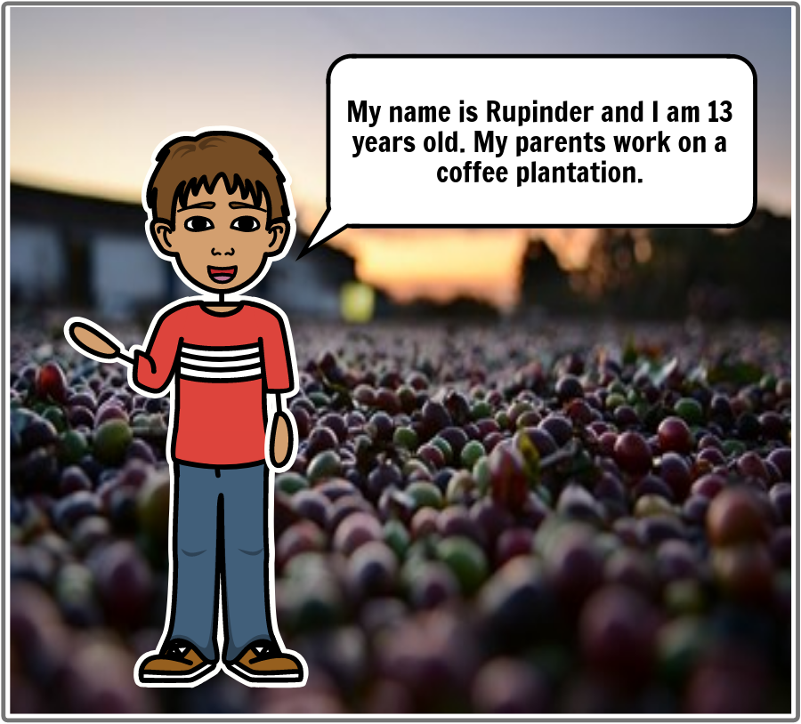
Question
Remember the story of Rupinder?
Why couldn’t he find a job when he went to live in the city?

Slide 30
Working Pictionary
Draw picture of one of the jobs you just saw or another job.
The members of your team will try to guess what the job is.
Notes:
Let’s play a game called Working Pictionary!
Draw picture of one of the jobs that they just saw while the students on his or her team guess what it is.
The members on the team have one minute to guess what it is.

Slide 31
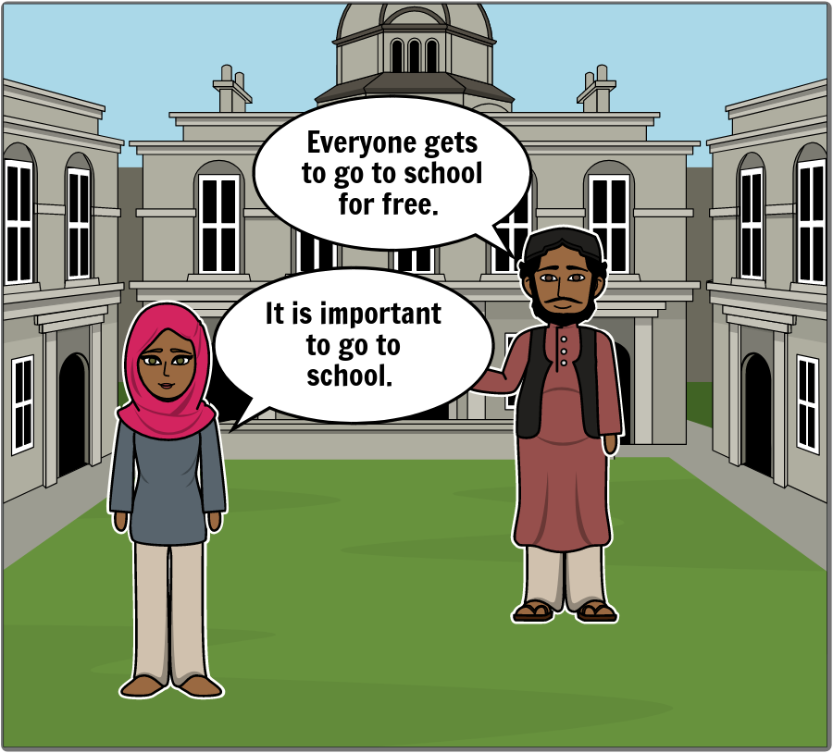
Conclusion
Notes:
SAY: Remember the story about Makala, who was not allowed to go to school.

Slide 32
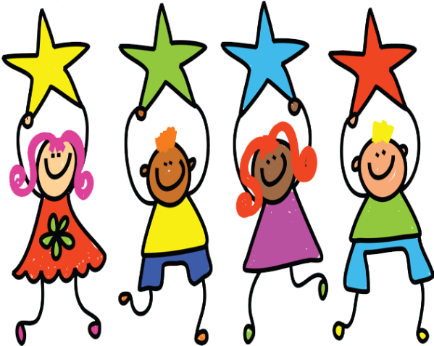
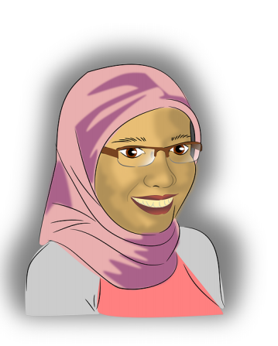
She is a brave and gentle advocate (or champion) of peace who became a global teacher just through the simple act of going to school.”
Notes:
SAY: This is what the leader of The United Nations said about Malala: “She is a brave and gentle advocate (or champion) of peace who became a global TEACHER just through the simple act of going to school.”

Slide 33
What does it mean that Malala was a teacher for everyone in the world?
Notes:
ASK: What does it mean when he says that just by going to school, she was a teacher for everyone in the world? Why did he say that? (Accept all answers.)
SAY: It was important for people to see Malala going to school even though the soldiers tried to scare her and make her stop. She was teaching by example that everyone has the Right To Education, and that it is important for everyone to go to school.

Slide 34
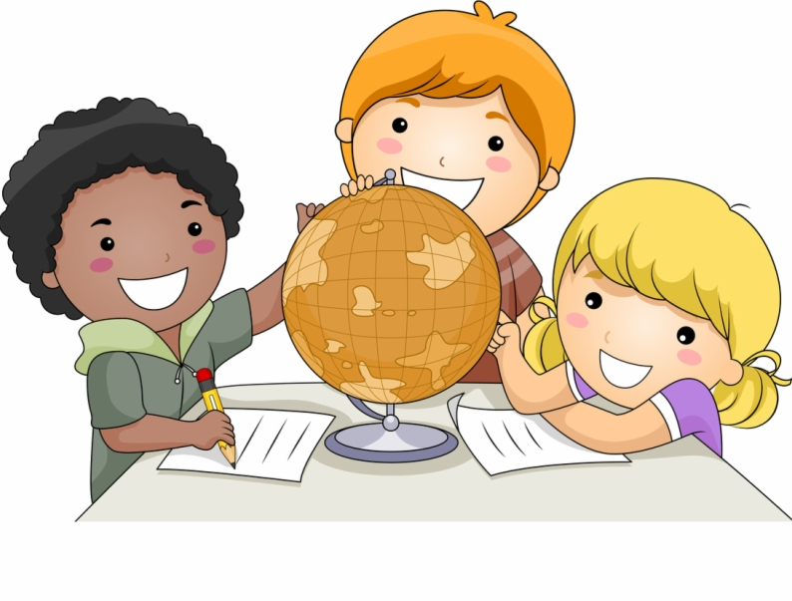
Conclusion
When you go to school and learn new things and share them with your friends and family, you are setting a good example.
Notes:
ASK: How can you be that kind of example? (Accept all answers.)
SAY: That’s right! When you go to school and learn new things and share them with your friends and family, you are setting a good example, too. It makes me really proud of you when I see you setting a good example for other people.

Slide 35
Learning Points
Education prepares you to learn skills you will need in the future.
All children have the right to an education.
Children can become teachers.
Notes:
1. Education prepares you to learn skills you will need in the future. 2. All children have the right to an education. 3. Children can become teachers.

Slide 36
Challenge
Tell someone about some of your favorite human rights you learned about.
Notes:
SAY: Tell a friend or someone in your family about some of your favorite human rights you’ve learned and that we’ve talked about here in our group over these last weeks together.

Slide 37
Challenge
Consider teaching others human rights values in a memorable way by creating a picture, a mural, a sculpture, a game, a poem, a story, a song, a dance, a play, a musical production or some other meaningful activity.
Notes:
SAY: Tell a friend or someone in your family about some of your favorite human rights you’ve learned and that we’ve talked about here in our group over these last weeks together.

Slide 39
References
1 | Visit the Geneva Office on Human Rights Education website to download and print lesson resources at www.go-hre.org
2 | United Nations Universal Declaration of Human Rights. https://www.un.org/en/universal-declaration-human-rights/
3 | United Nations Convention on the Rights of the Child. https://www.ohchr.org/en/professionalinterest/pages/crc.aspx

Slide 40
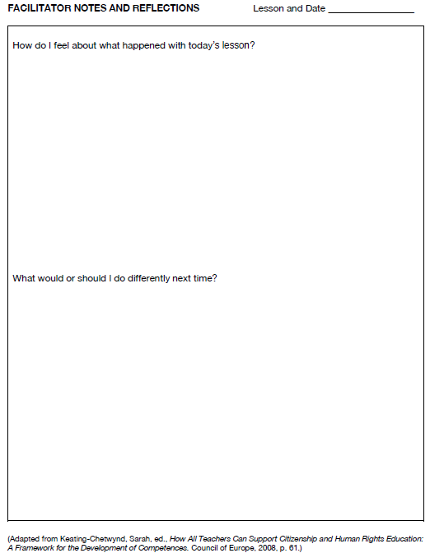
Resources

Slide 41
Resources

Slide 42
Universal Declaration on Human Rights Article 26
You have the right to go to school. You should be able to learn a profession or continue your studies as far as you can.
Your parents have a right to choose how and what you learn.
You should learn about the United Nations and how to get along with other people and respect their rights.
Resources

Slide 43
Convention on the Rights of the Child Article 28
Children have a right to an education.
Discipline in schools should be done fairly, with kindness and respect.
Primary education should be free and required.
Resources

Slide 44
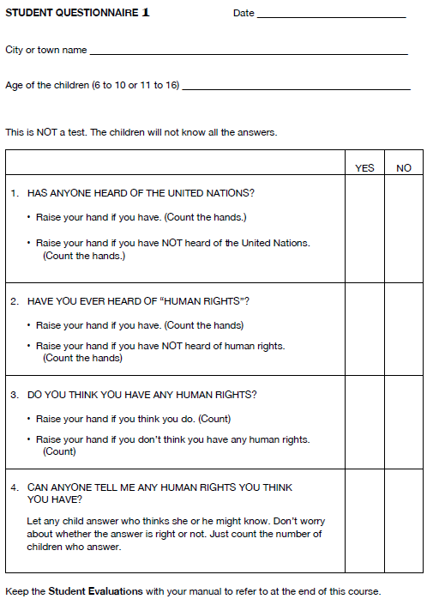
Resources

Slide 45
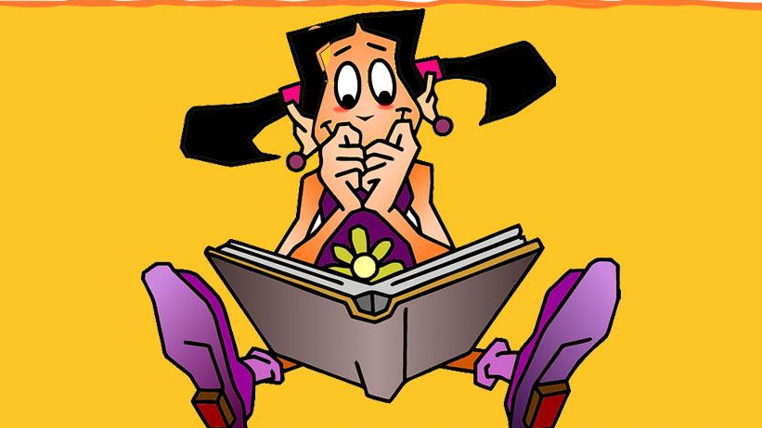
I Get to Go to School 1 Lesson 10B
Colega
Geneva Office of Human Rights Education

